Slide 1
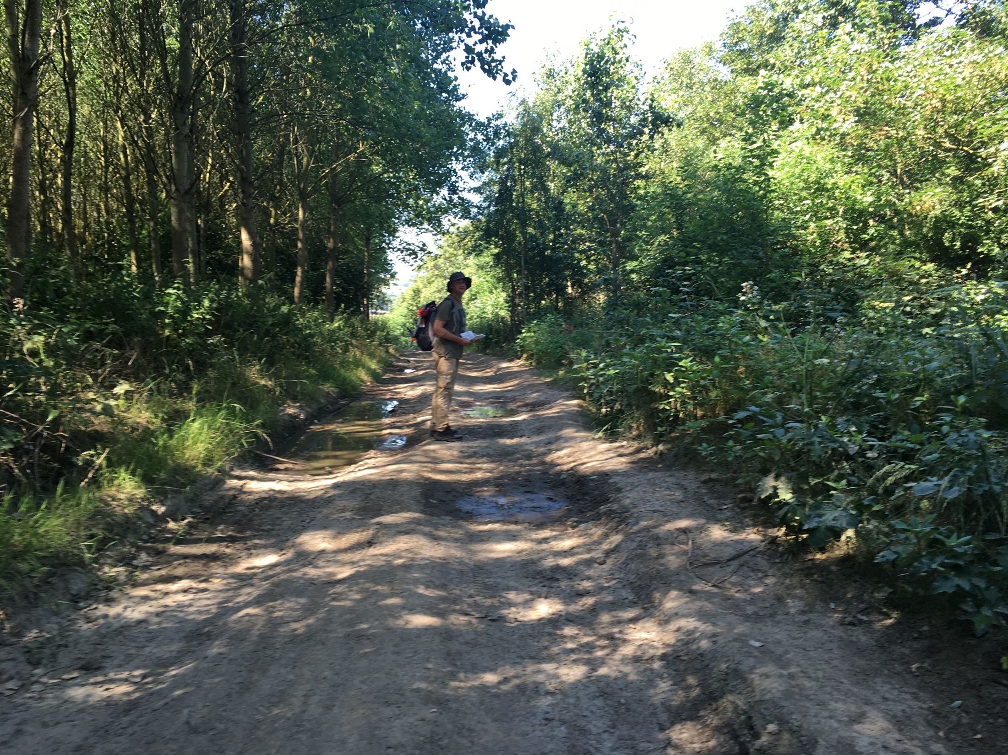

Boundary No Boundary
A physical exploration of the Wakefield District Boundary
By Tony Wade

Slide 2
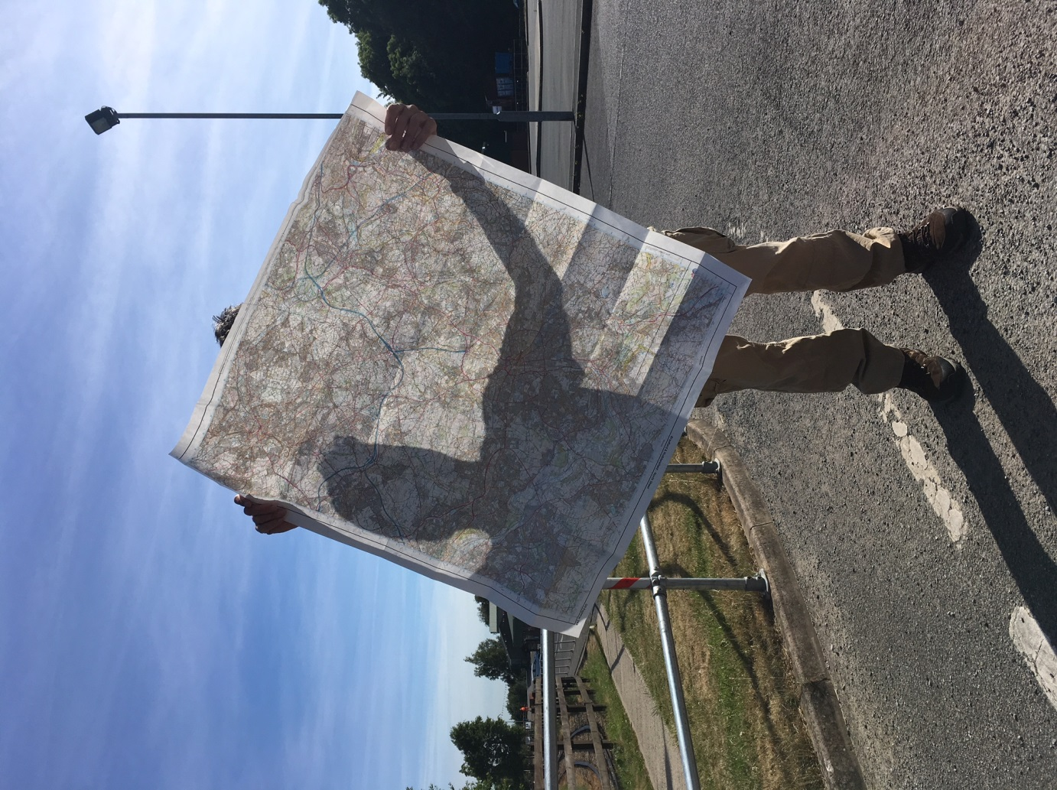
Notes:
Like most things this project started with an idle moment whilst looking at an OS map. I was curious about the different marks that were used to describe things,

Slide 3
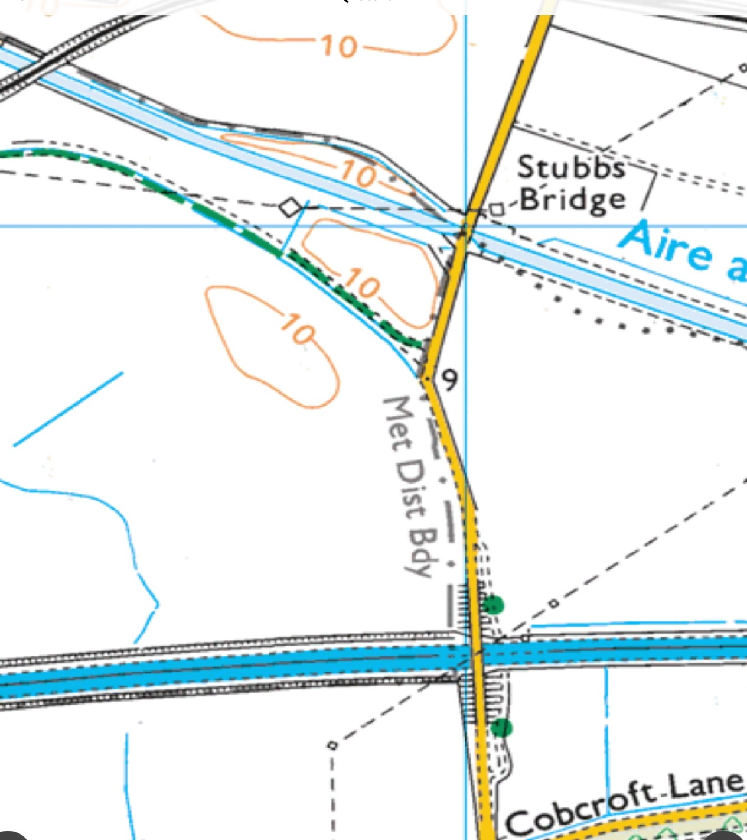
Notes:
Different lines and colours, shapes..an almost abstract thing.
Then I noticed the metropolitan boundary line.

Slide 4
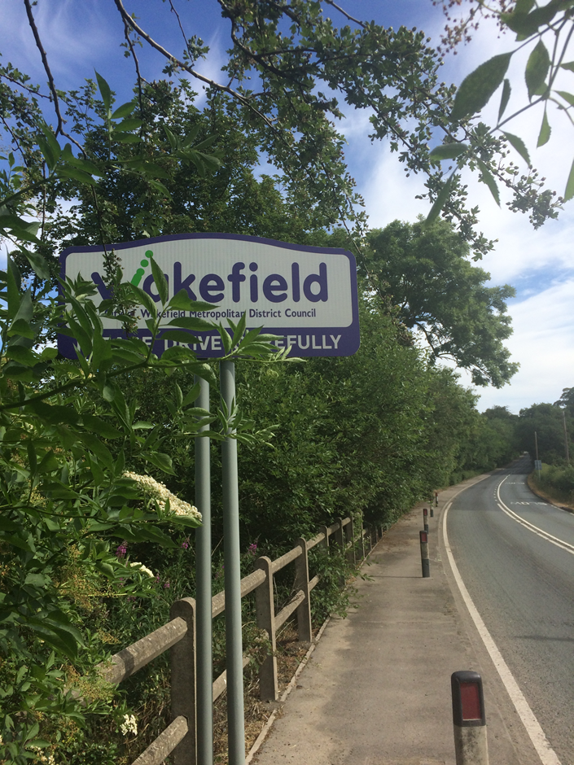
Notes:
I’ve lived and worked in Wakefield since moving there from East Yorkshire when I became student at Bretton Hall in the 80’s. Since leaving college I’ve worked as a community artist in most of the towns, villages, estates across the Wakefield district and I found two thing that unites them all.
1-They really don’t like each other.
Castleford doesn’t like Pontefract, Featherstone doesn’t like Castleford. Knottingley doesn’t like the outside world in general and they all don’t like Wakefield

Slide 5
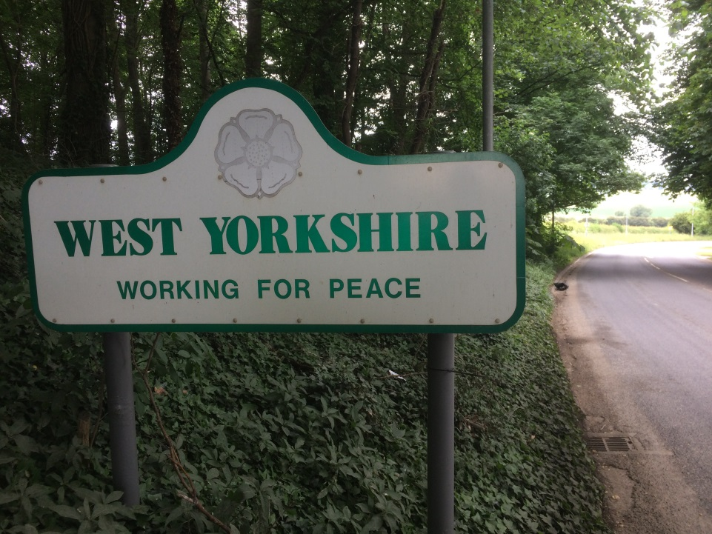
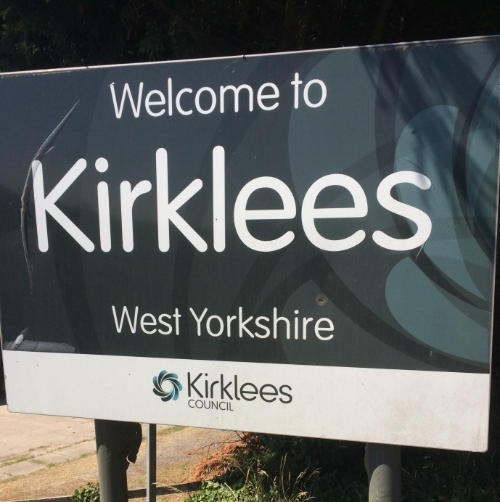
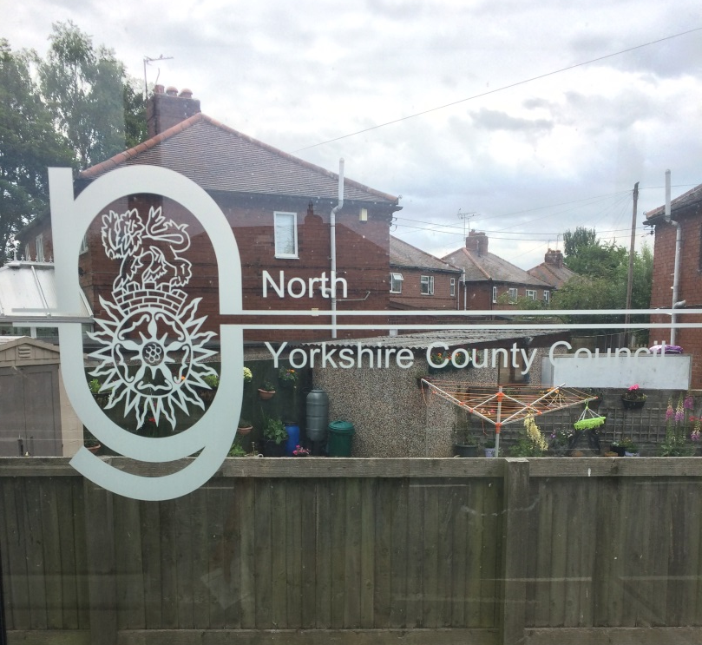
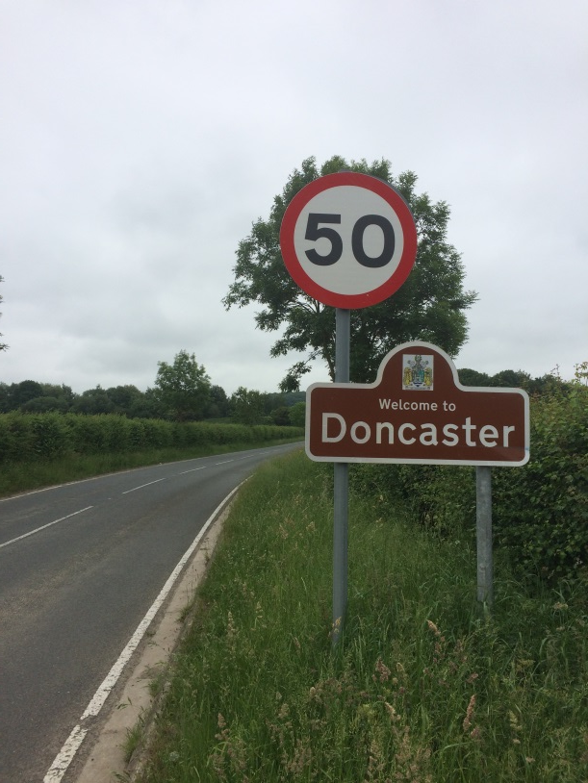
Notes:
(and that is a generalisation and there are many things that do unity them. All have a sense of pride in their local area, all are willing to highlight the positive aspects of their community and many have connectivity through shared history, especially the coal mining heritage, but also through canal links)
The other thing is this little grey dashed line that reigns them all together.
So I got to thinking what is this boundary? Was there a connection between Ossett in the West and Knottingley in the East, just because they both lay on the boundary
Bounda rys are a strange thing and a very contentious thing especially as we are entering a post brexit world.
The boundary is a linear space that physically exists but has little actual presence. Does where you call home, either side of this invisible line, affect how you think about yourself? Are you from Wakefield, Leeds, Barnsley etc? Many are unaware of where the actual line is.

Slide 6
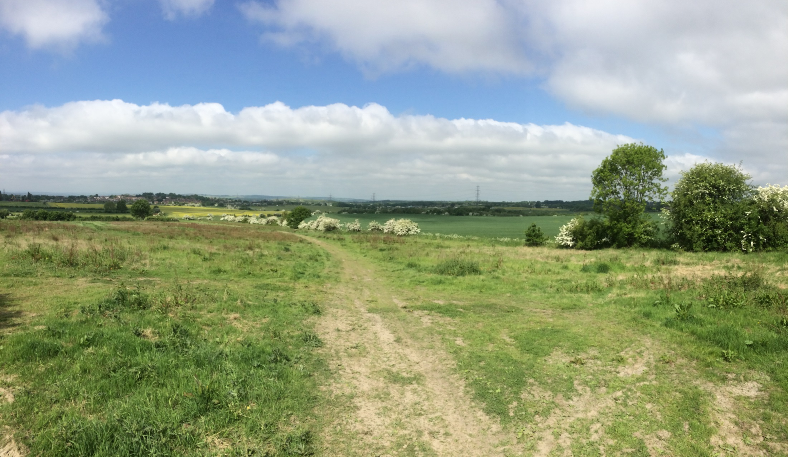
Notes:
I looked up some facts.
The present Wakefield District boundary was set in 1974 by the Local Government Act 1972, when the county borough of Wakefield merged with the West Riding municipal boroughs of Castleford, Ossett and Pontefract, the urban districts of Featherstone, Hemsworth, Horbury, Knottingley, Normanton and Stanley, along with Wakefield Rural District and parts of Hemsworth Rural District and Osgoldcross Rural District.
We are often calling for unity and a sense of shared identity, promoting community cohesion. What symbols can we use to draw people together?
How about the shape of this district.;
I got quite excited about this
What does this line look like?

Slide 7
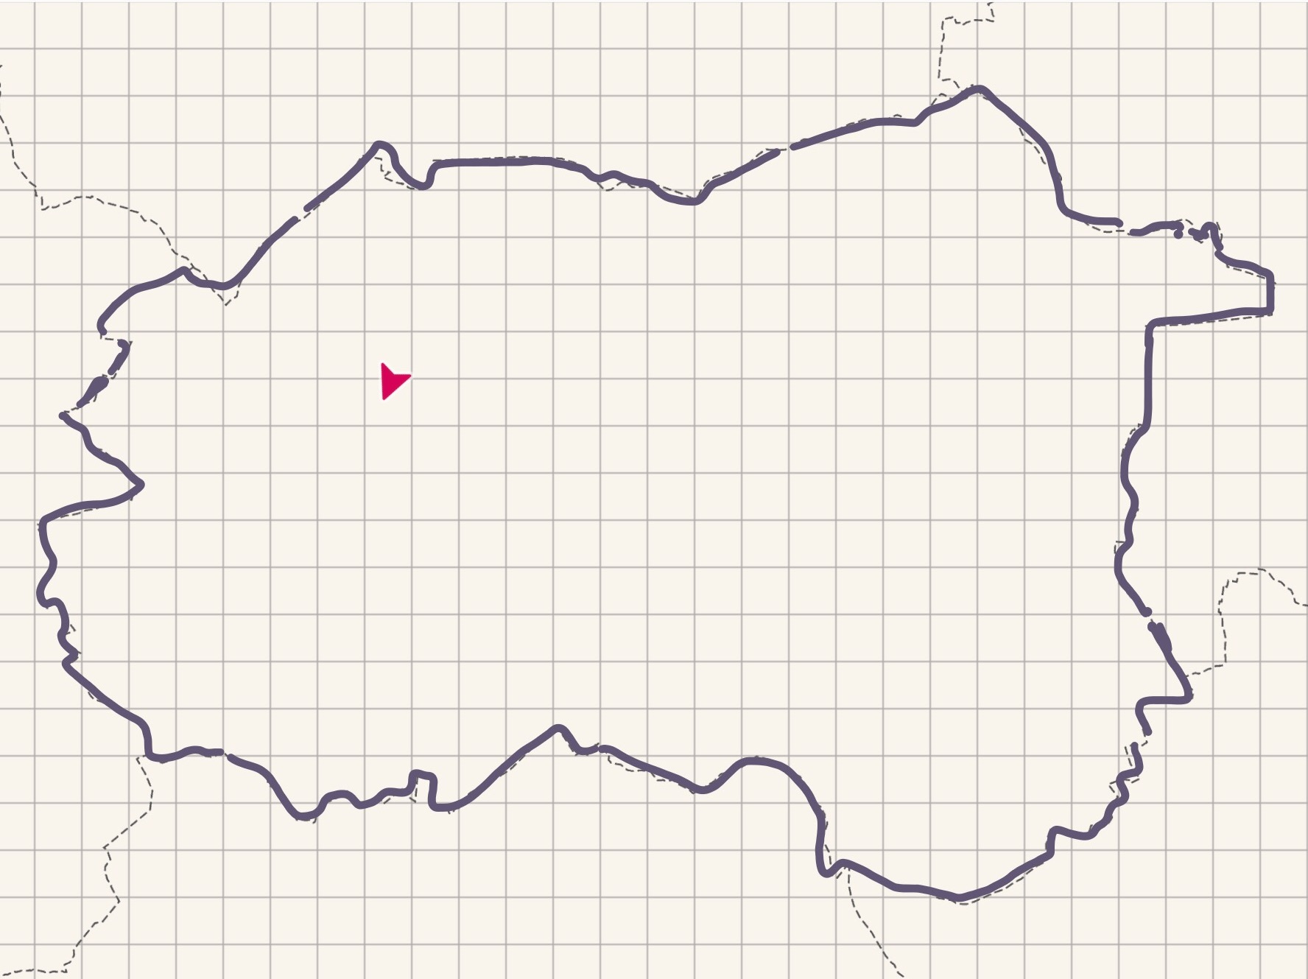
Notes:
I drew it over the OS app and it looks like this
That’s right…a deformed kidney with Donald Trump’s face on the side of it!

Slide 8
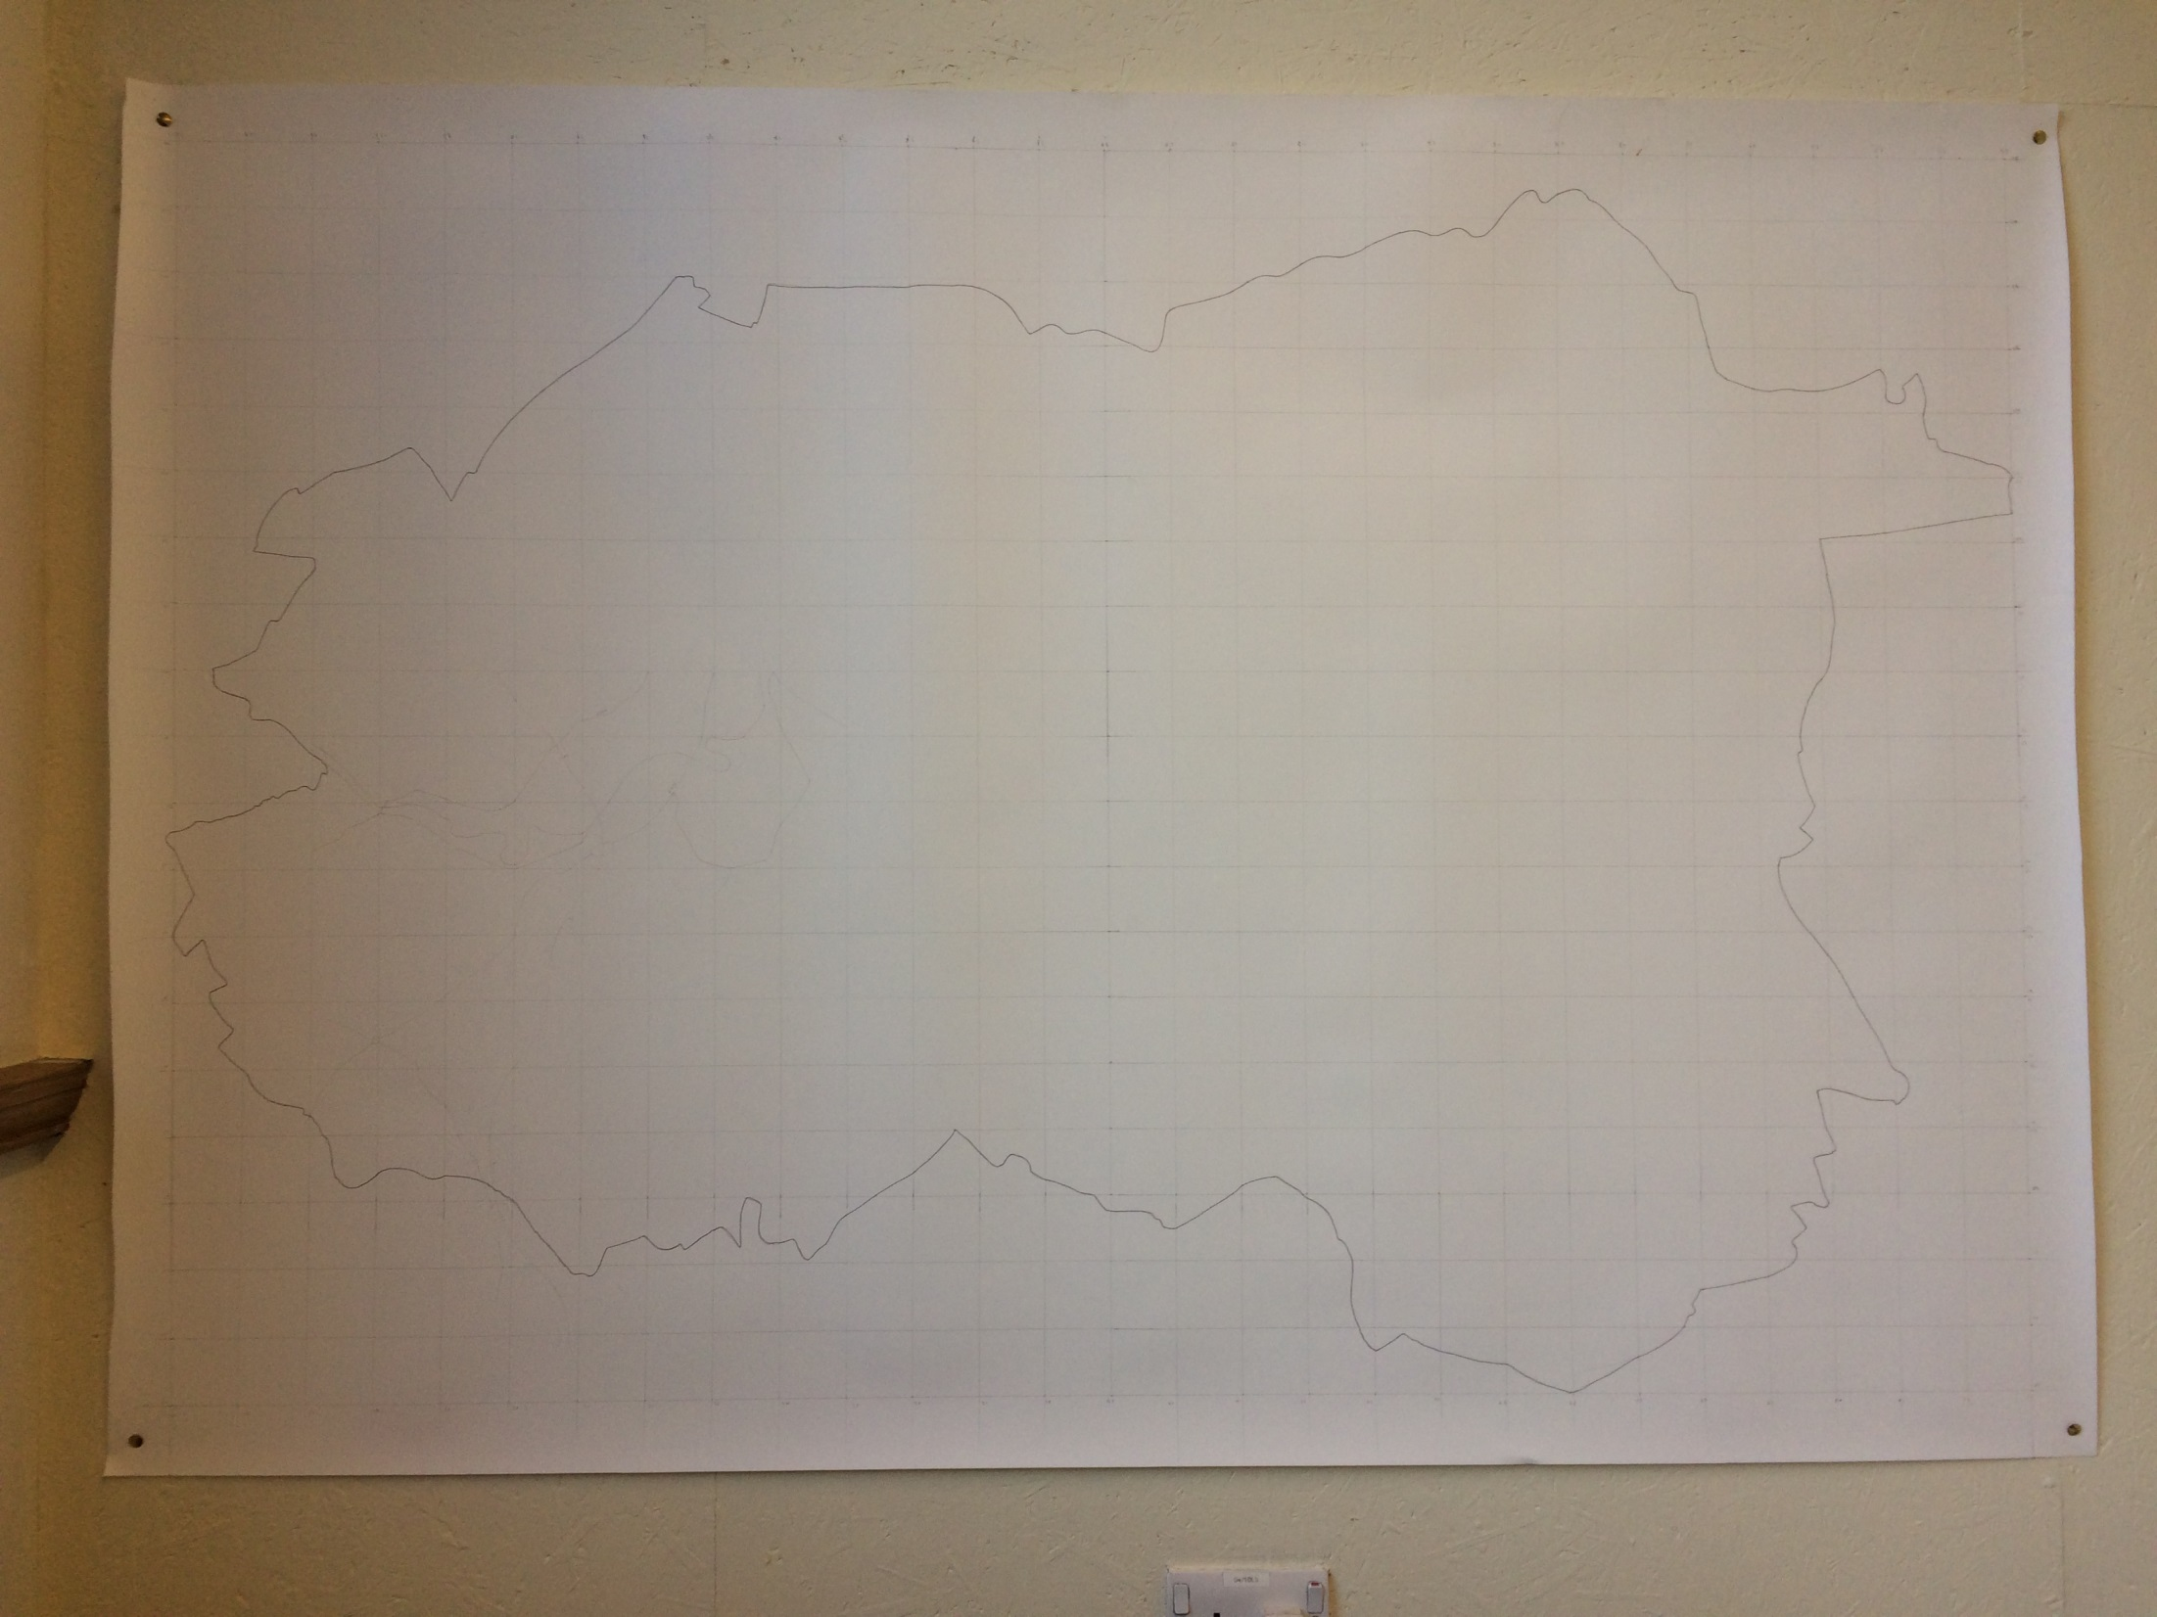
Notes:
Further exploration was required.
I drew it on a large piece of paper.

Slide 9
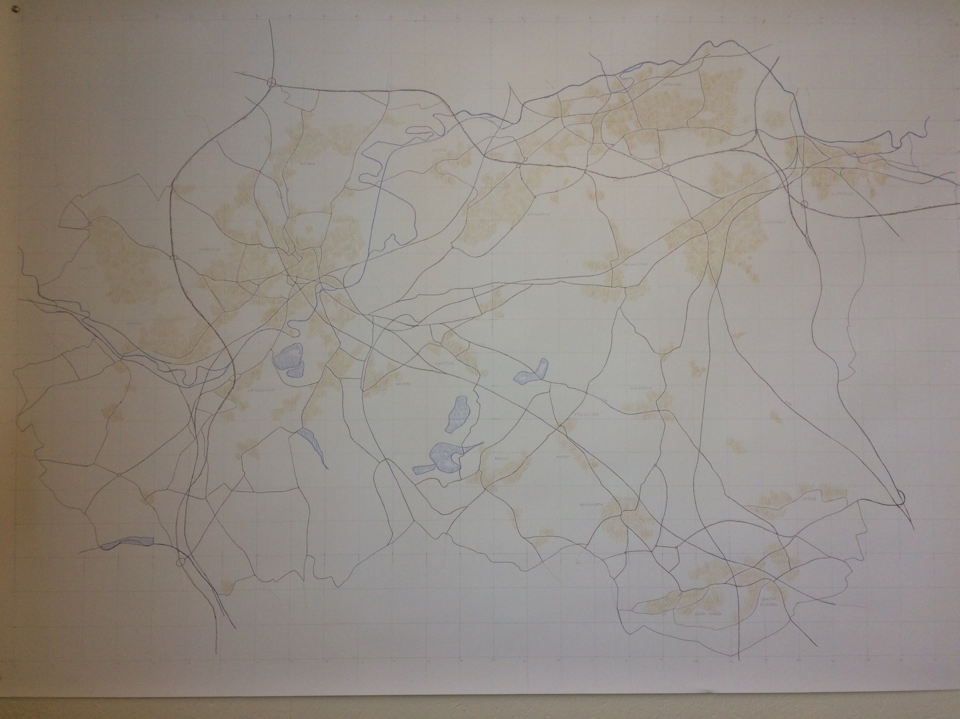
Notes:
I then started to fill in the towns, villages, roads, rivers..seeing where they ran along side the boundary.
Very soon the boundary got lost again.
I looked at the actual dashes that made up the boundary and wondered how big they were. I had a notion a getting a roll of lino cut to the size of each dash and laying it over the landscape to make the line a physical thing.
I tweeted OS the to ask

Slide 10
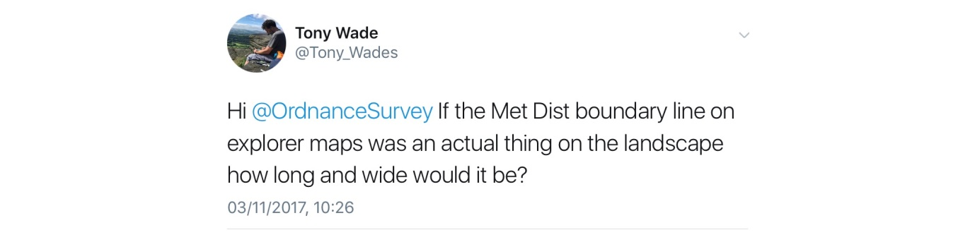

Slide 11

Notes:
So I did a bit of measuring and figured out each dash was 50m long by 1m.
I went to the park over the road with some tent pegs, hazard tape and a tape measure and made this.

Slide 12
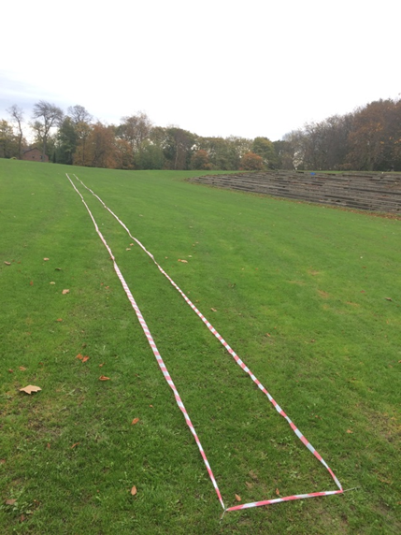
Notes:
I excitedly tweeted OS

Slide 13
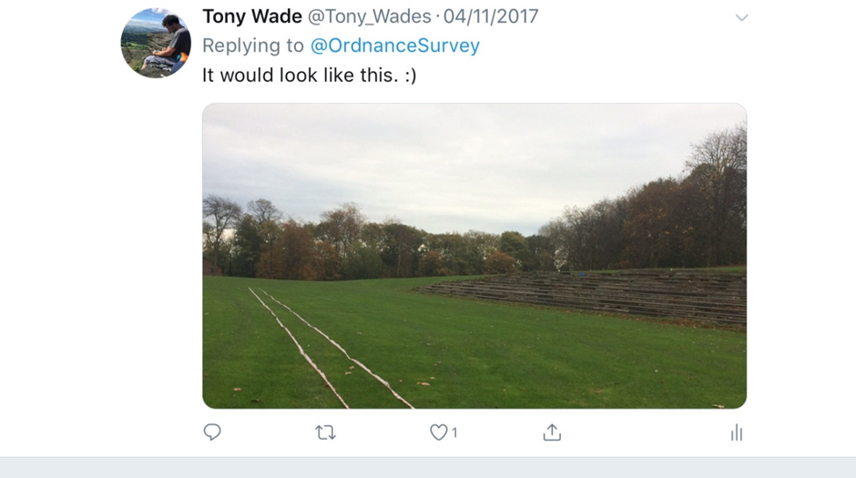
Notes:
They didn’t respond.
I also abandoned my lino project.
So I went to have a look at it.

Slide 14
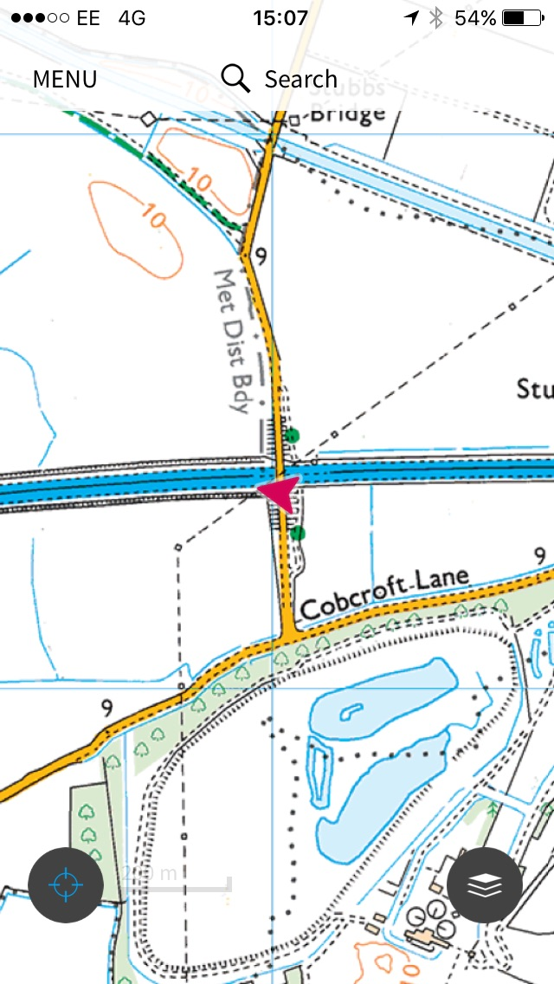
Notes:
I drove the point furthest east. Made sense as I was born in East Yorkshire so I might as well look at the boundary between my childhood in East Yorkshire and my adult life in West Yorkshire.

Slide 15
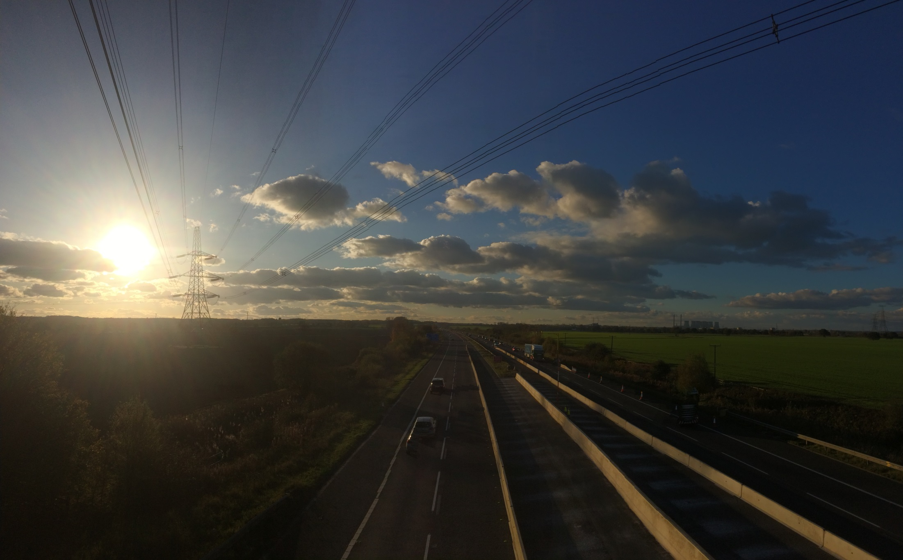
Notes:
And I looked at along the boundary

Slide 16
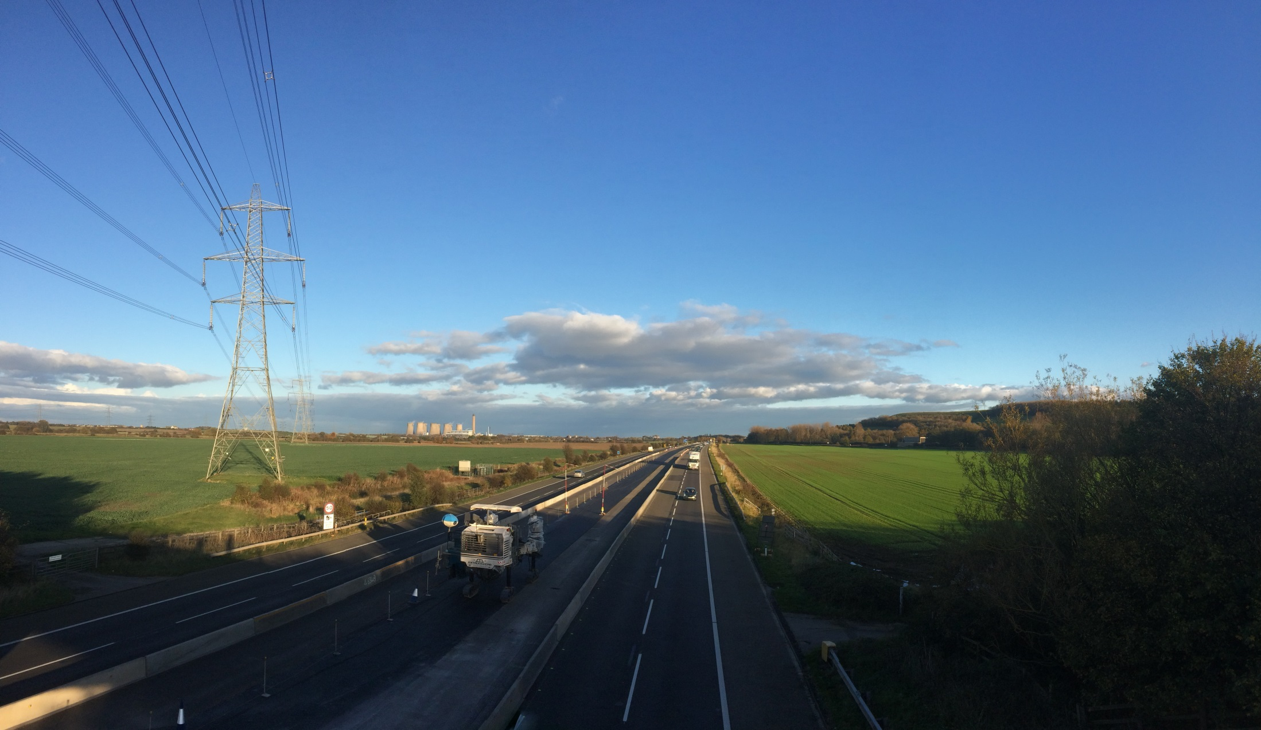
Notes:
I looked outwards. And it wasn’t East Yorkshire. Someone had put North Yorkshire in the way.

Slide 17
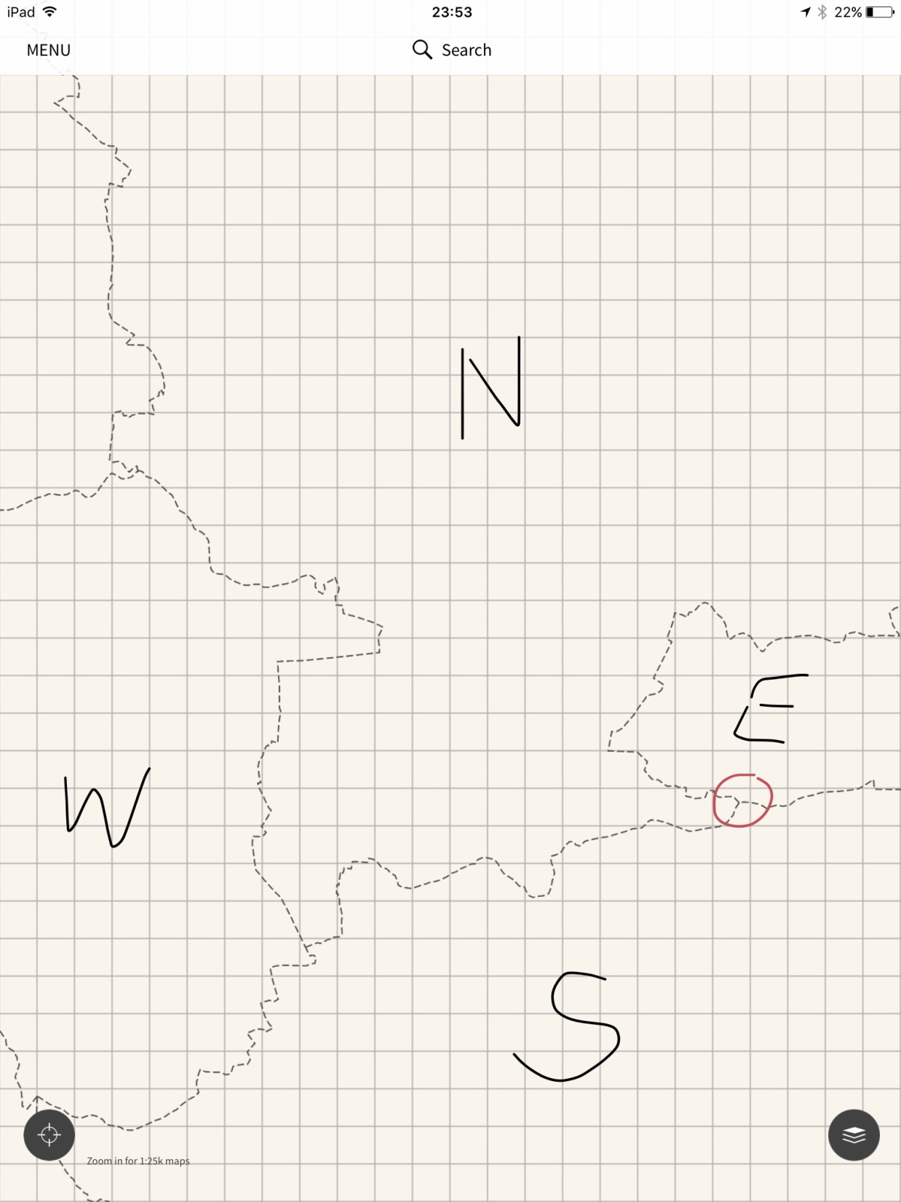
Notes:
I noticed this interesting feature, the point where North Yorkshire met East and South Yorkshire. I drove to the nearest village parked the car at Pollington and walking for 3 hours across fields.

Slide 18
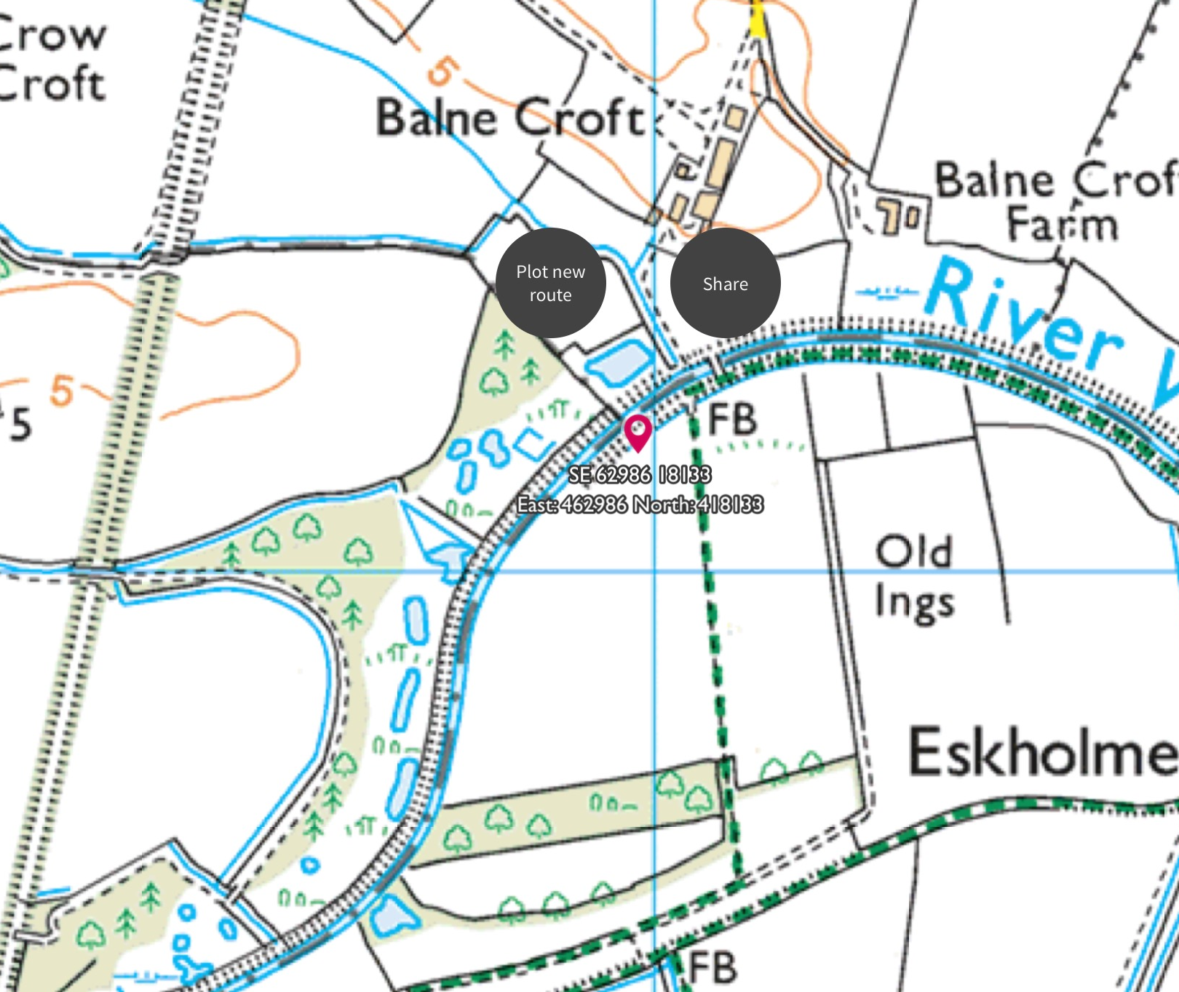
Notes:
There I was, in North Yorkshire looking north into East Yorkshire with South Yorkshire to the east.
It looked like this

Slide 19
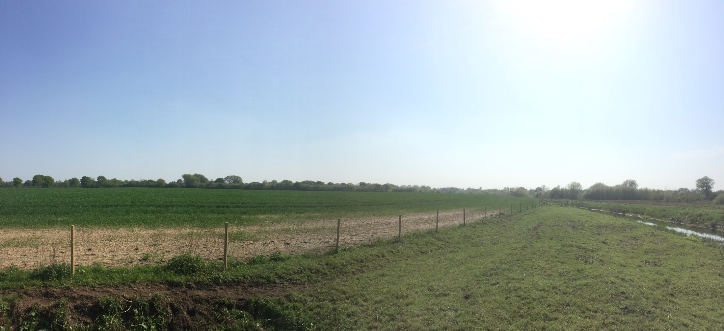
Notes:
I was getting distracted so I went home to have a think.
It was then that I decided I had to walk the boundary line, talk to people I met, ask them if they were aware of it, record their testimonies, photograph it. Create a web site to house all the documentation.
I curiously asked via social media if anyone know how long the boundary would be.
200 miles at least. Must be over a 1000
I asked Wakefield Council if they knew how long it was. The replied that they didn’t.
They knew the area but never had cause to measure the circumference. Fair enough
So I got a bit of string and started to measure. And it turned out to be a disappointing 60 miles.
I bought a map measuring wheel to double check and it was still 60 miles.
With great excitement I came up with a plan.
I will divide it in to 20 x 3 miles stages.

Slide 20
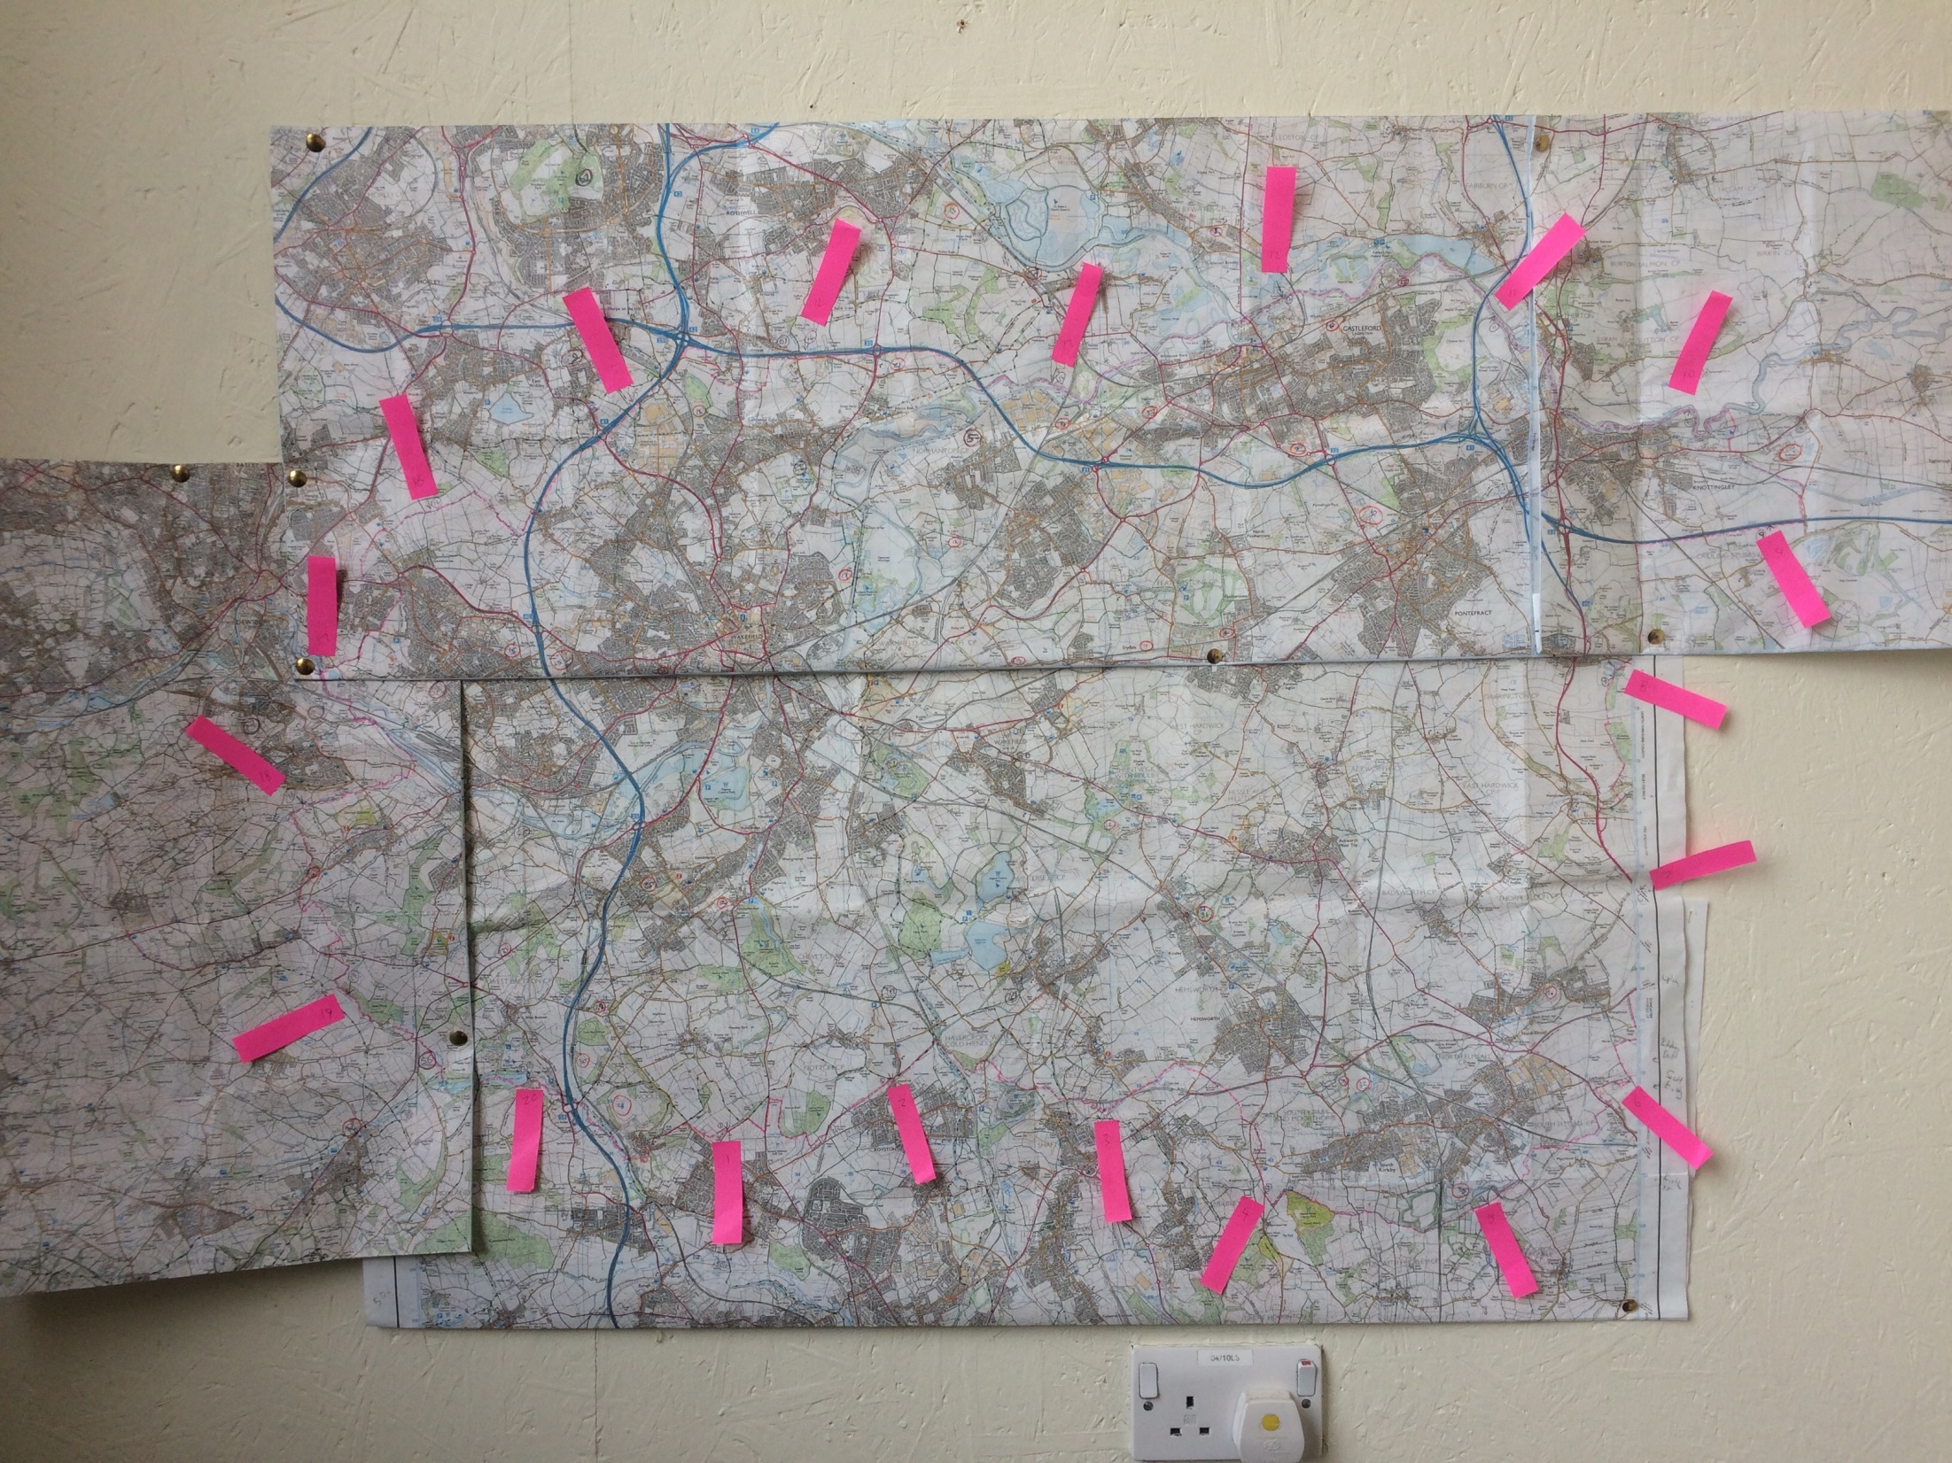
Notes:
I will walk and explore this space. The act of walking the space echoes the Beating the Bounds traditions where people would walk the parish boundary to share the knowledge of where they were.
I will invite people that live near the boundary on either side to join me. I wish to find out what this boundary means to them. Do they acknowledge it? Ignore it? Dismiss it?
I also decided to paint it.
I will find a place in the middle of each stretch to paint. I will paint on three panels (40cm x 20cm) recording what I see in 90 degrees from horizon to horizon looking outwards from the district. On a flat landscape the visible distance to the horizon is approximately 3 miles. The completed series of paintings will record a complete view from the boundary looking out.
I wondered what it would be like to view the outside world from the vantage point of the district. What if all the administration, geography, history, experience was condensed into you, the viewer and you could look out on the areas that surround you. What would you see?
What would you feel?
How would it even work.
What could possible go wrong?

Slide 21
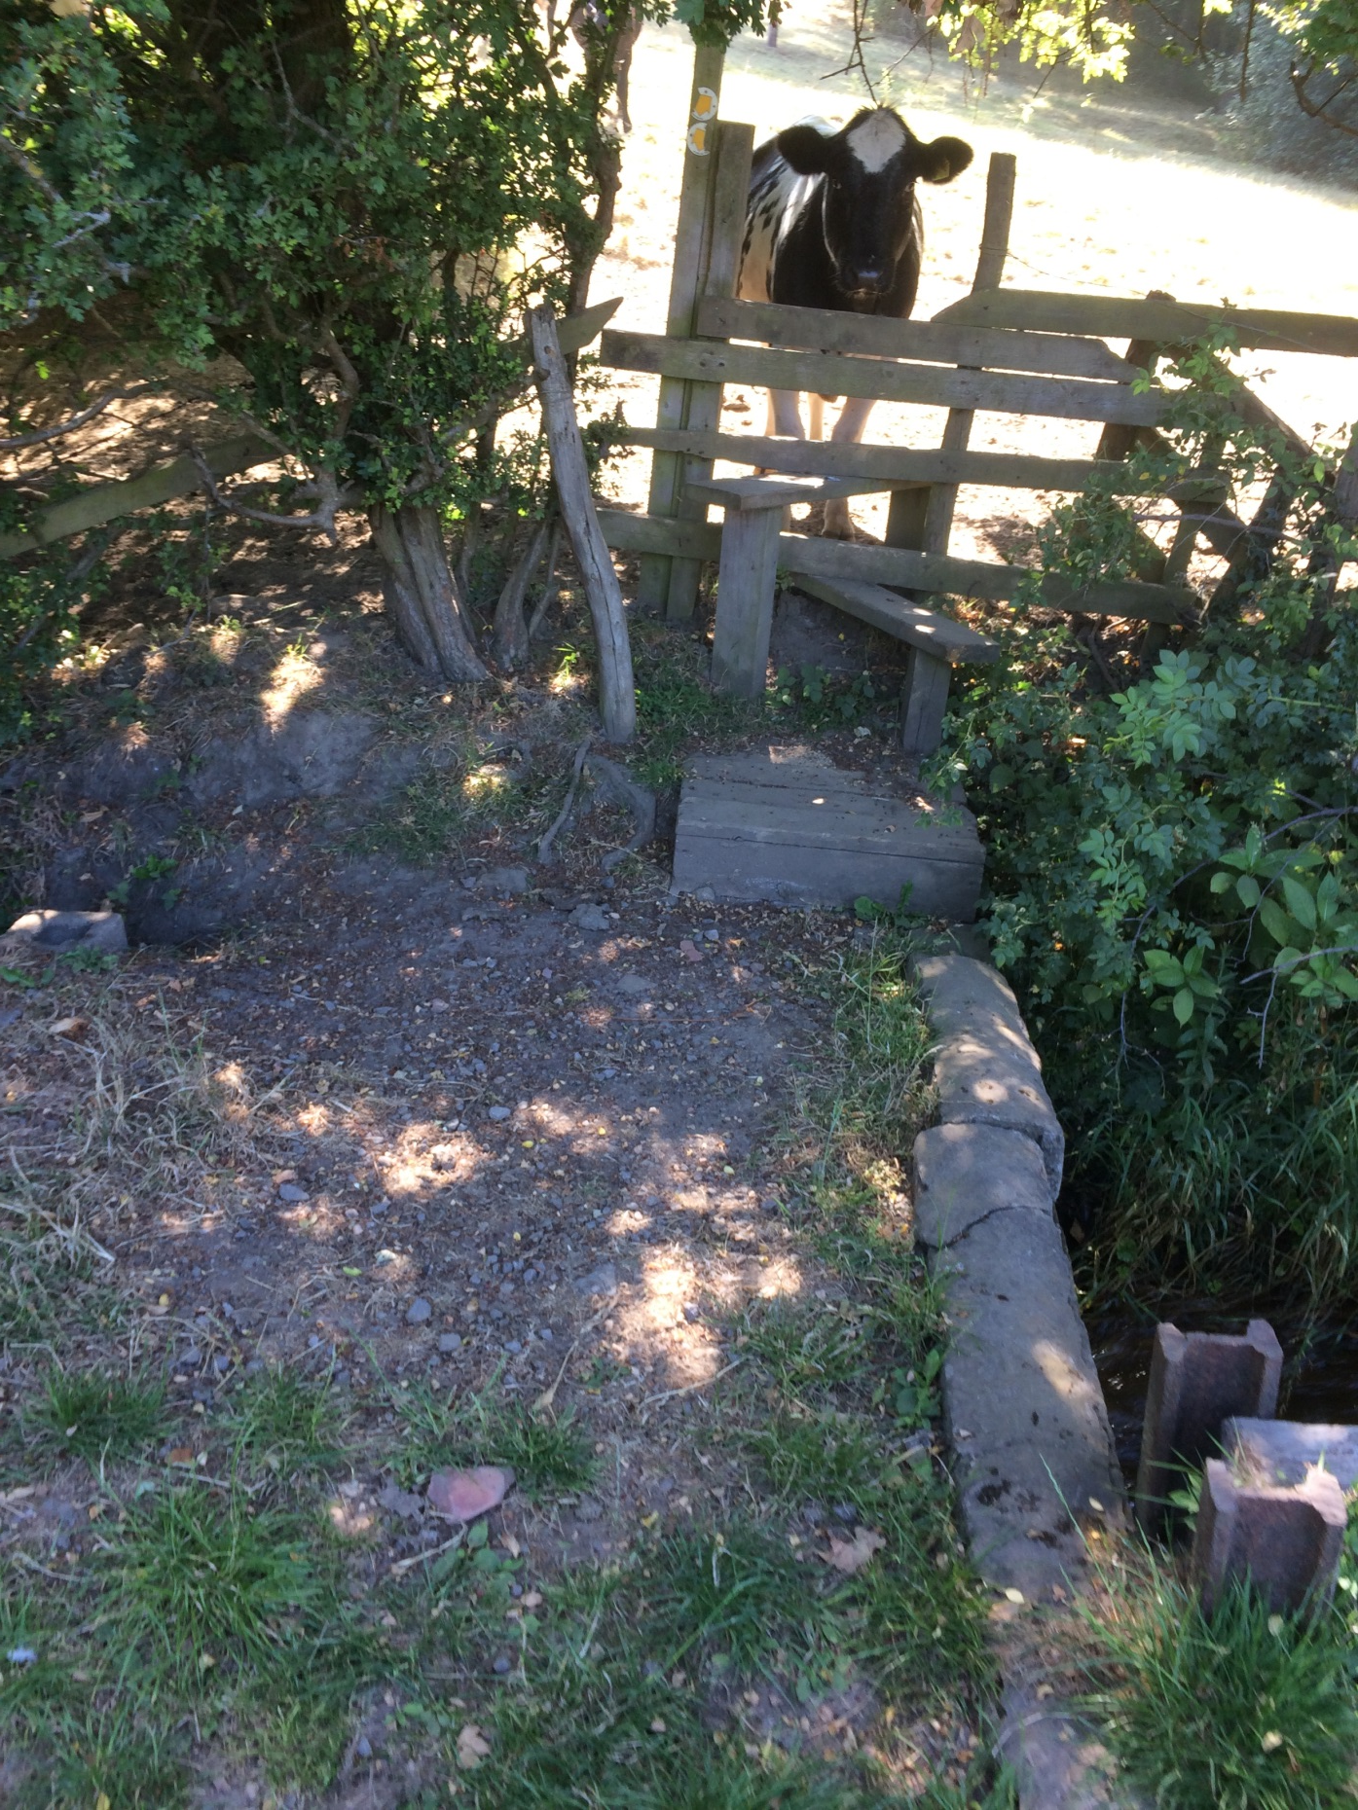
Notes:
On the 15th May 2018 I set off on Stage 1, from the dam at the end of the Lower Lake at Yorkshire Sculpture Park and headed east. I had several Ordinance Survey maps with me, (in paper form and as an app on my phone,) all my painting kit including 3 wooden painting panels, sting relief spray, hay fever tablets, a stool, a camping table, a battery pack to recharge my phone, lots of water and a vague notion of where I was heading.
I'd marked the Wakefield District boundary on my map with pink highlighter and marked the start and end of each stage.

Slide 22
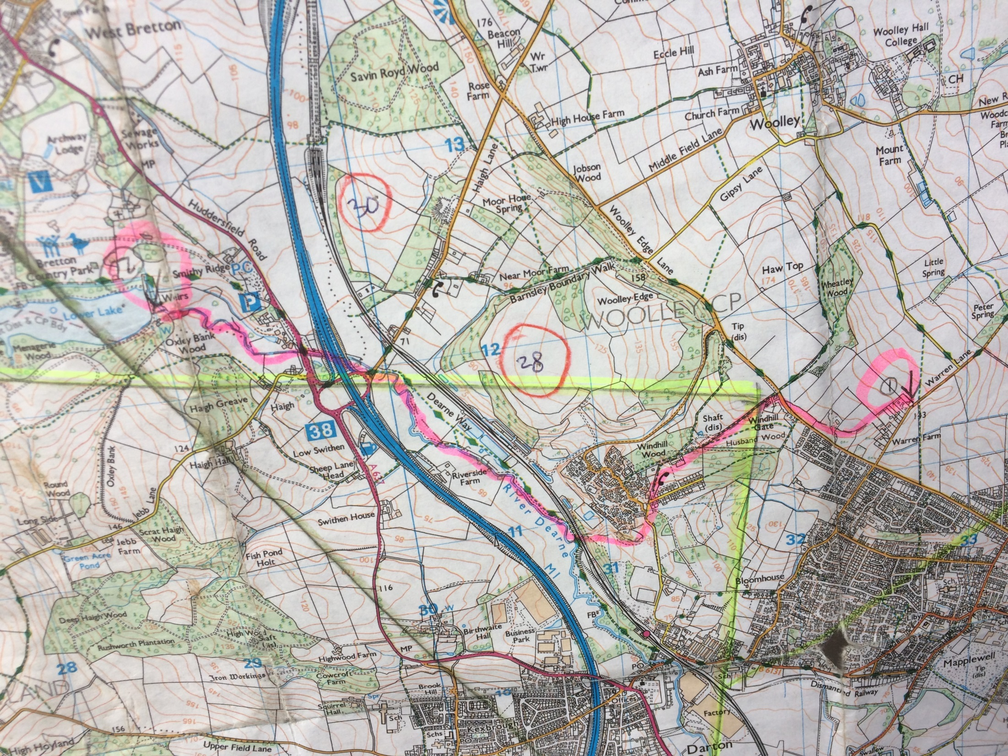
Notes:
Note - The numbers in the photograph relate to colliery sites and is part of another project but I soon realised that my route would take me through many reclaimed, disused or neglected ex-coalfield areas.

Slide 23
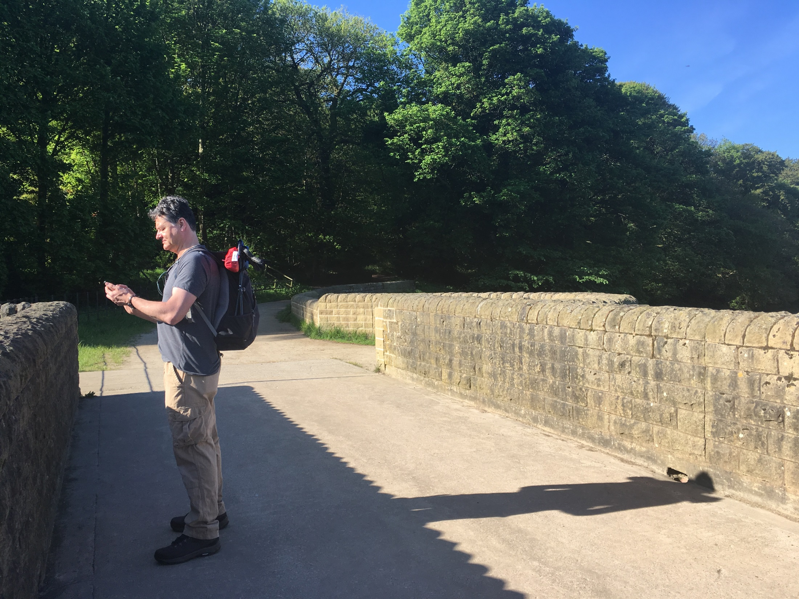
Notes:
At the start of the stage I took a screen grap of my location along with a photograph of where I was heading and uploaded these to the Boundary No Boundary Facebook page and Twitter using the hashtag #BoundaryNoBoundary
I wanted people to be able to follow my progress as the project unfurled.

Slide 24
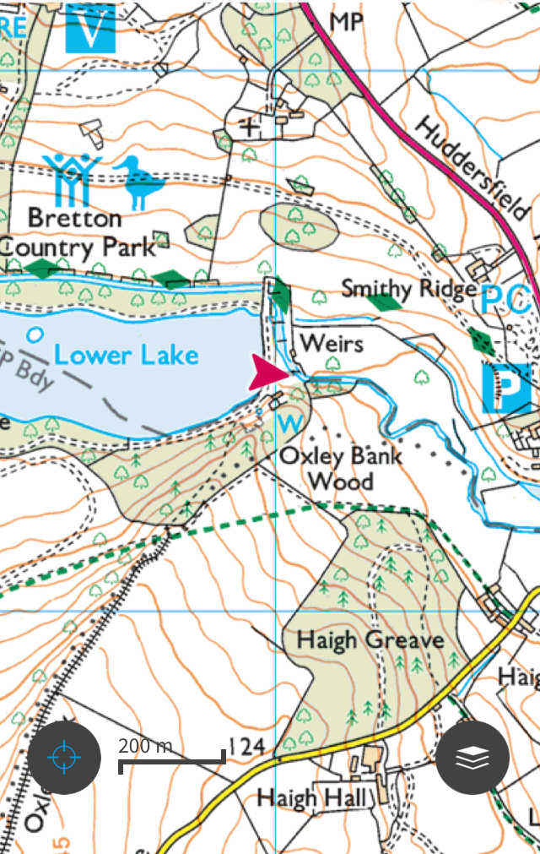

Slide 25
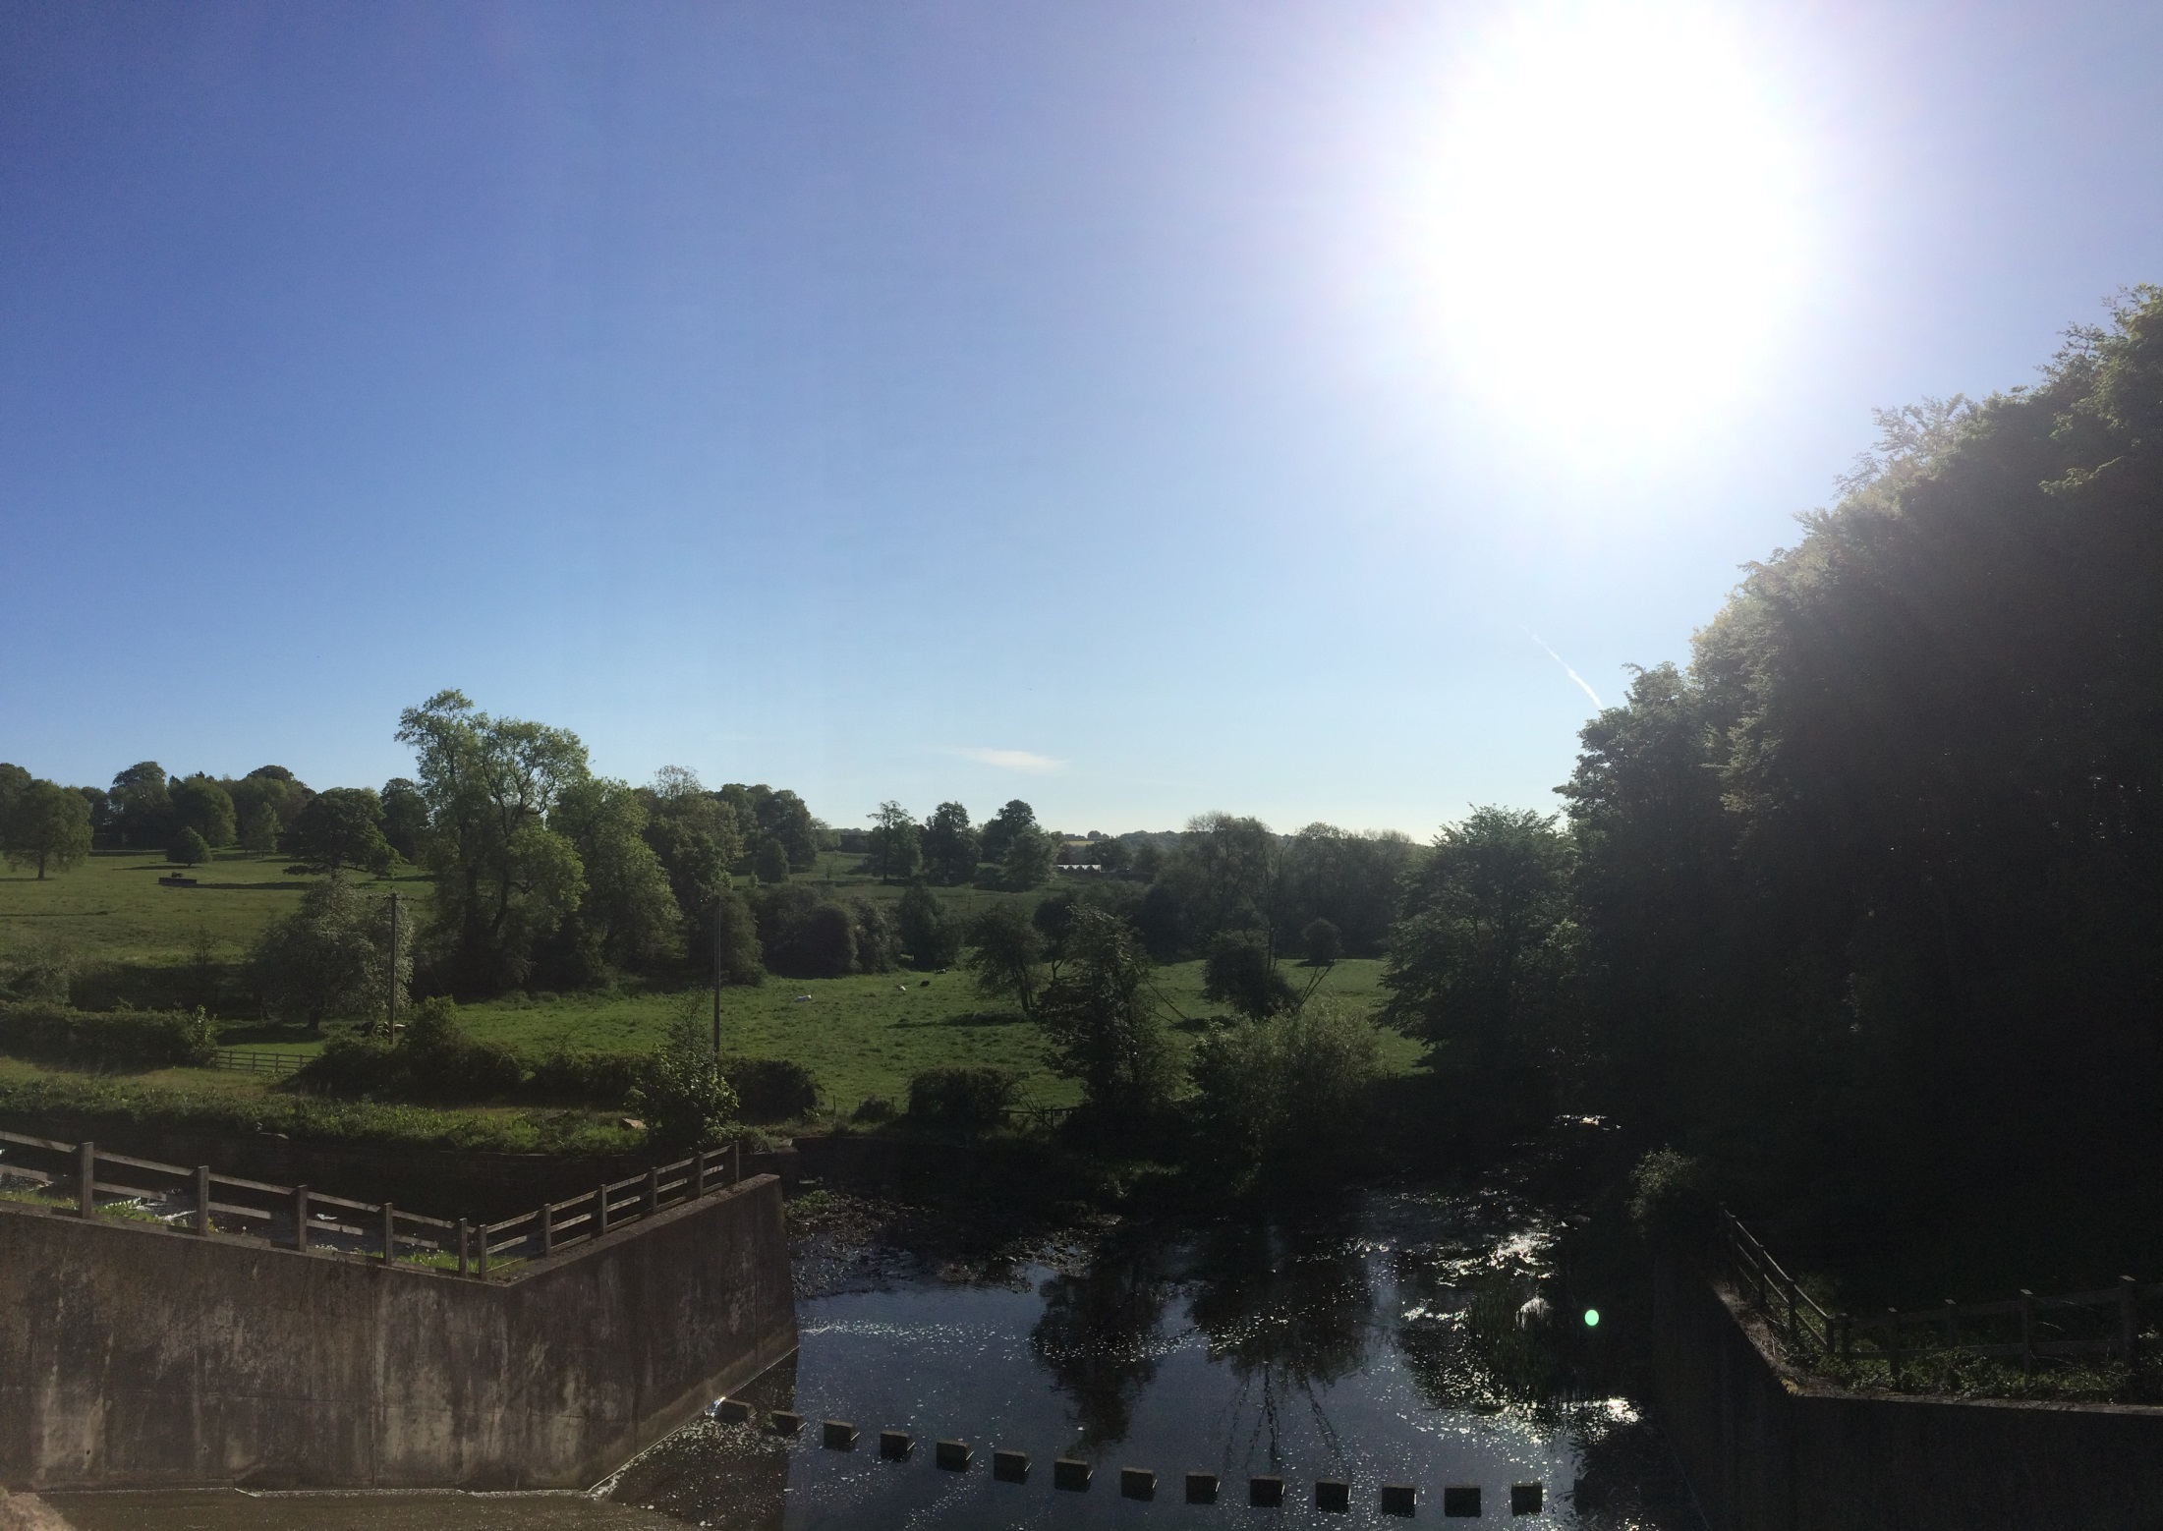
Notes:
It was a very hot day. This good weather continued, pretty much, for the entire duration of the project. I kept on imagining I was cursed/blessed (depending on your perspective) and that I was undertaking some ritual connected to the weather. I had a lot of time to think such thoughts.
After leaving the sculpture park grounds the boundary crossed the A637, headed under the M1 and out into open fields.

Slide 26
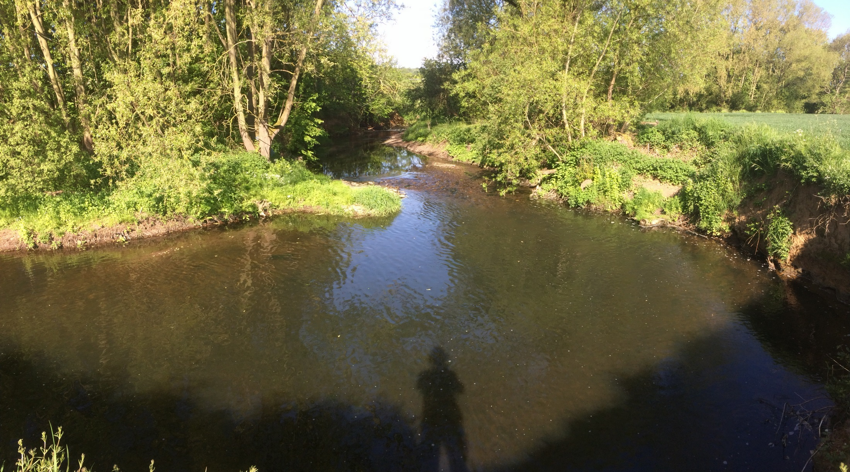
Notes:
The boundary followed the River Dearne for the first half of the journey which was proving to be quite a pleasant experience. I recorded the sounds I heard on my phone. (They can be found on the Sounds page)
The boundary then disappeared down a tunnel under a railway line

Slide 27
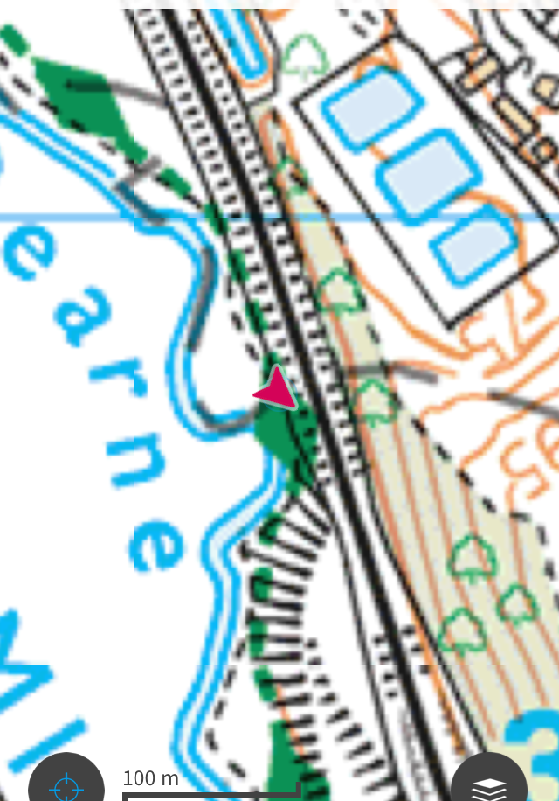
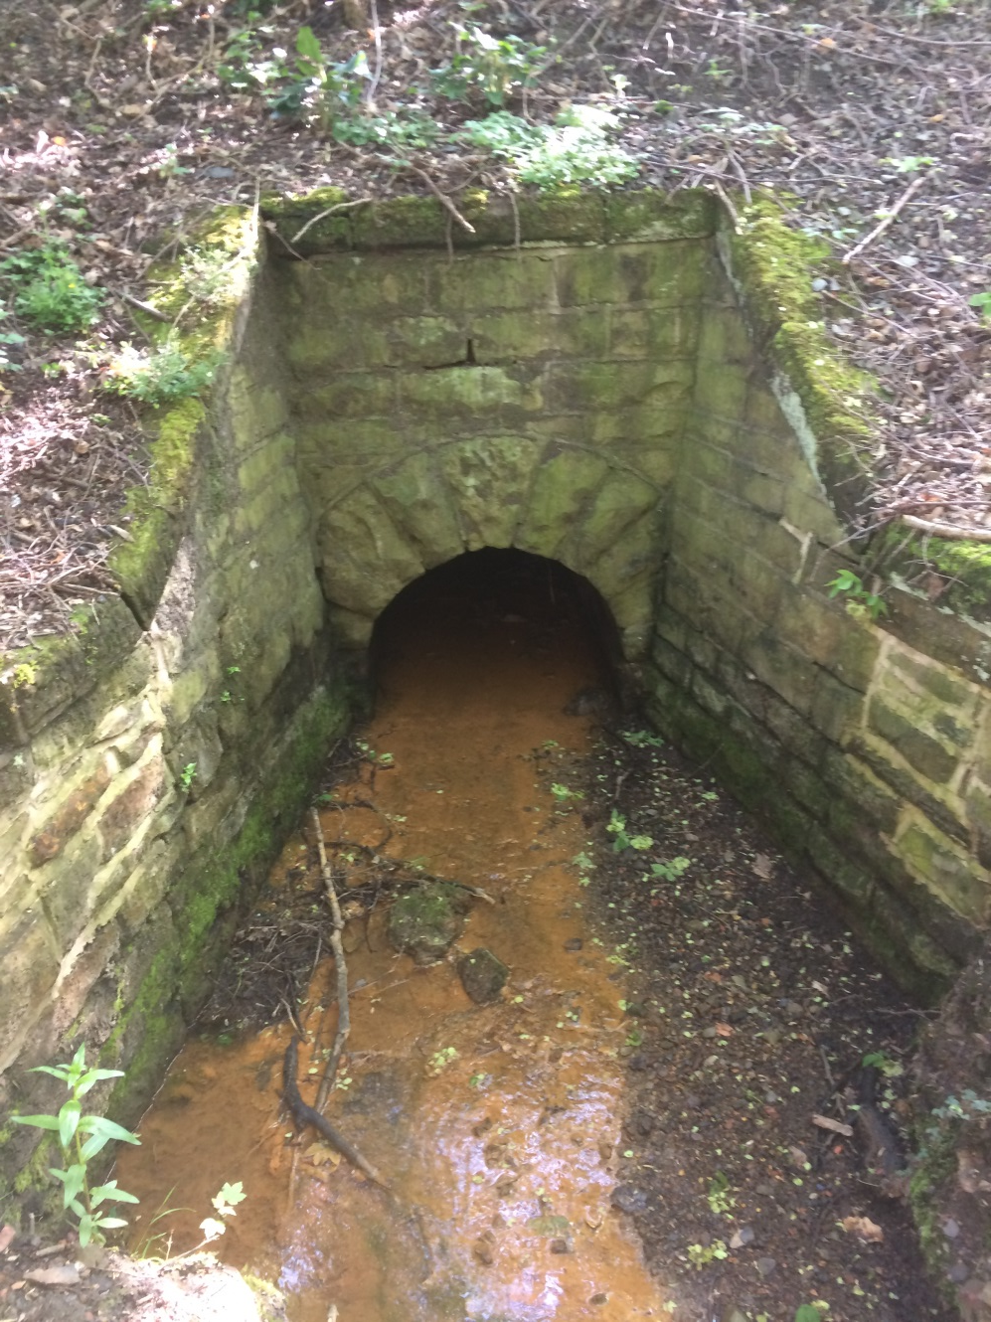
Notes:
Tempting though it was I decided not to crawl through the tunnel but elected to follow my plan of staying as close to the boundary as possible without harming myself, trespassing or being reckless. So I headed to Darton.
I talked to people on the journey and explained what I was doing. I handed out postcards I'd had printed with details of the wedsite, email address and other ways of getting in touch and being involved in the project.

Slide 28
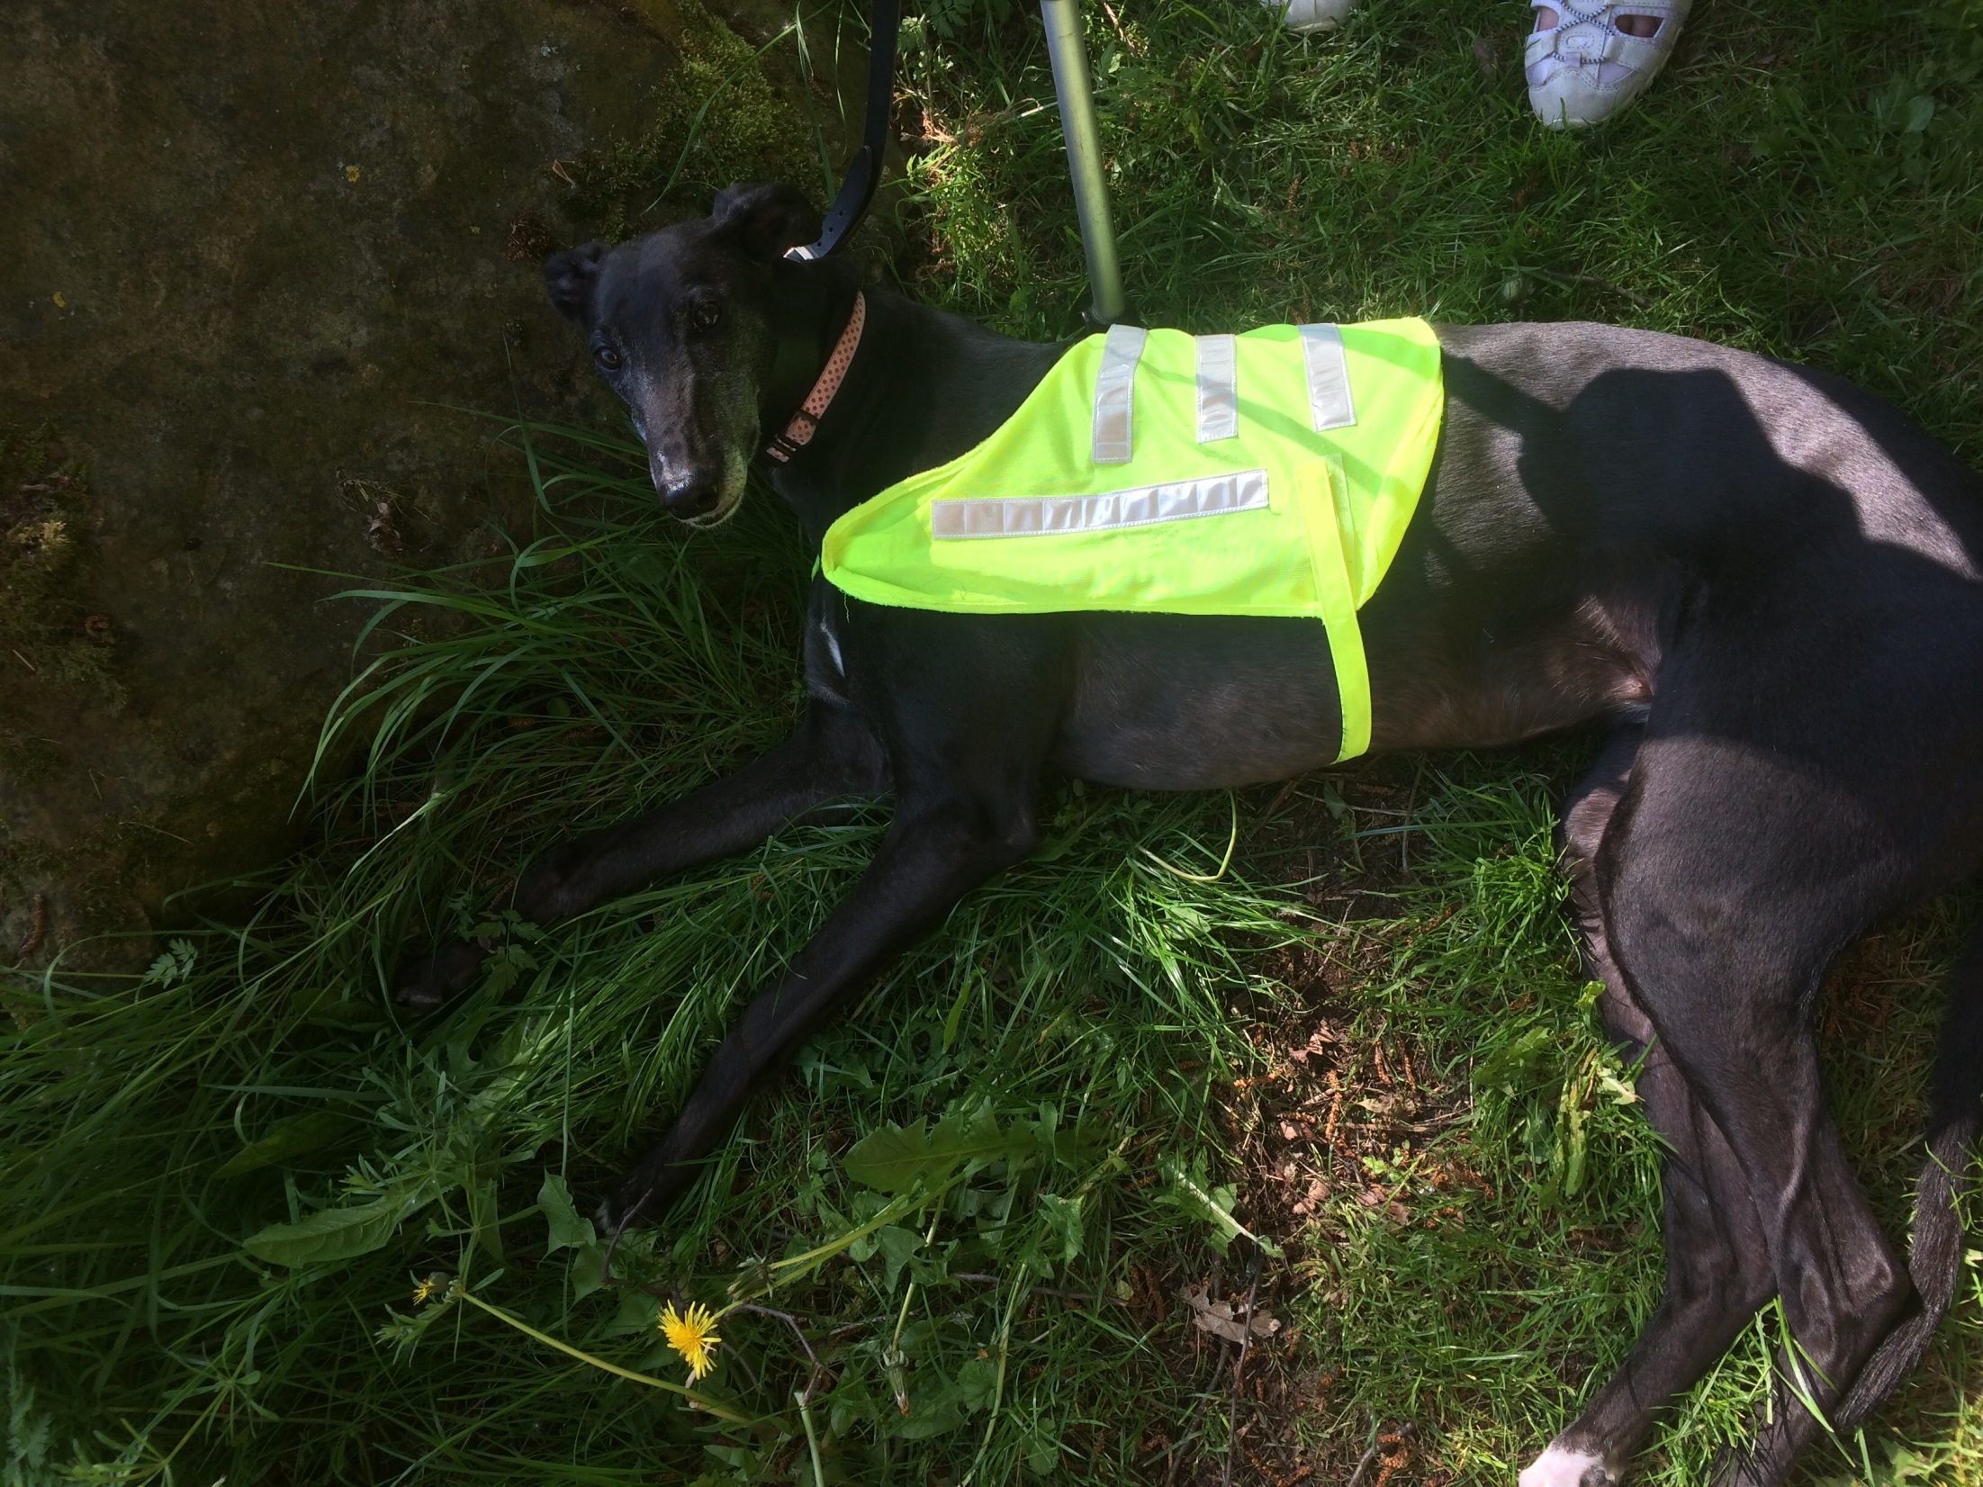
Notes:
I made notes of conversations as I went. I met a woman walking her dog. I explained what I was doing and asked her what she thought about the boundary. She thought Wakefield was a strange place. She called it Lego town as they keep on moving things about there, always building, always knocking down.They were knocking down the library now! Which was a surprise to me as that’s where my studio is. I was fascinated how someone could have such a strange and almost fanciful view of a place that is only the other side of this line. I asked if she’d ever been. She replied “I was born there, I’ve only lived in Darton a few years”

Slide 29
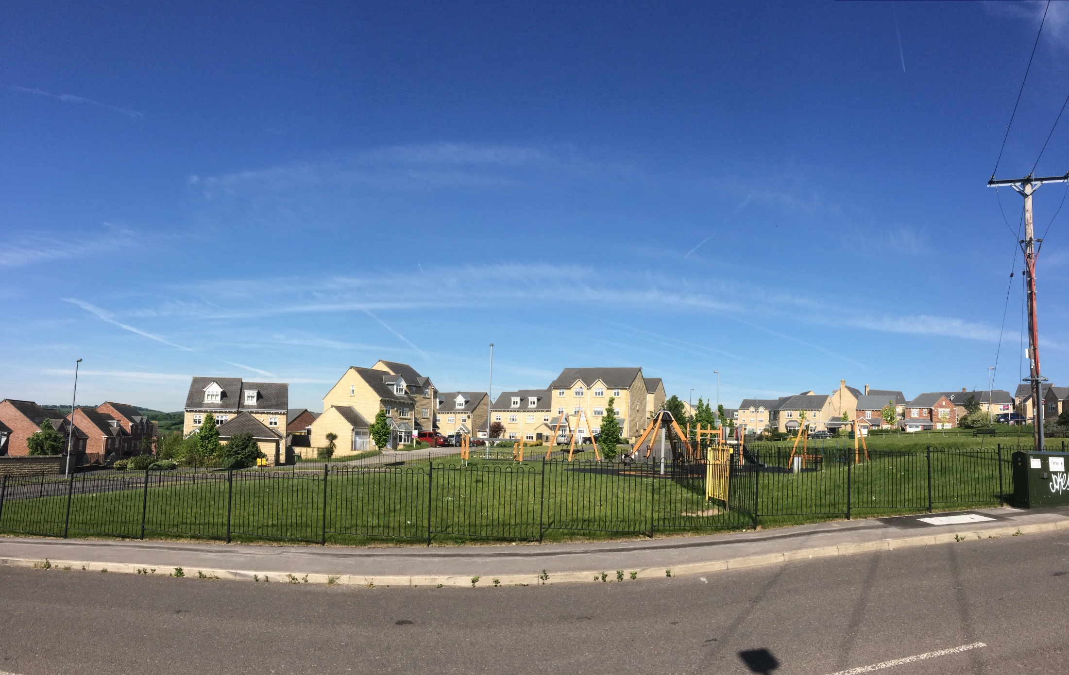
Notes:
To get back to the boundary I had to detour about a mile but soon picked it up again at Woolley Grange, a new housing estate built on the site of Woolley Colliery. This was at the top of a steep hill that forms part of Woolley Edge

Slide 30
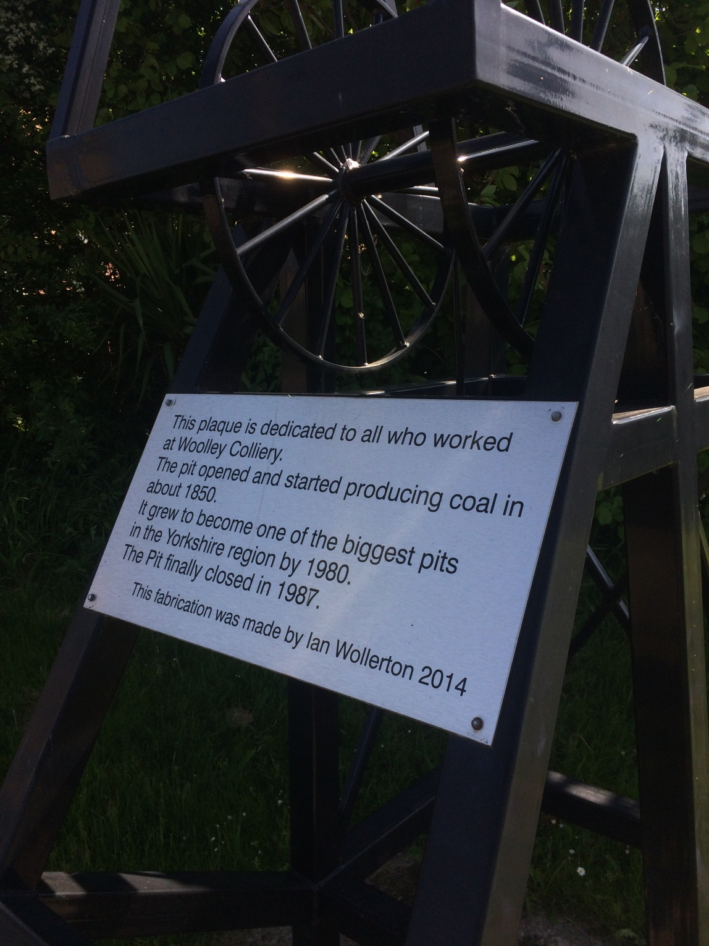
Notes:
There's still a couple of rows of terrace houses left from the original Woolley Colliery Village built to house the miners. There's a memorial to the pit there but all that's left of the pub is the pub sign and the school is now a house, The rest is scrub land.

Slide 31
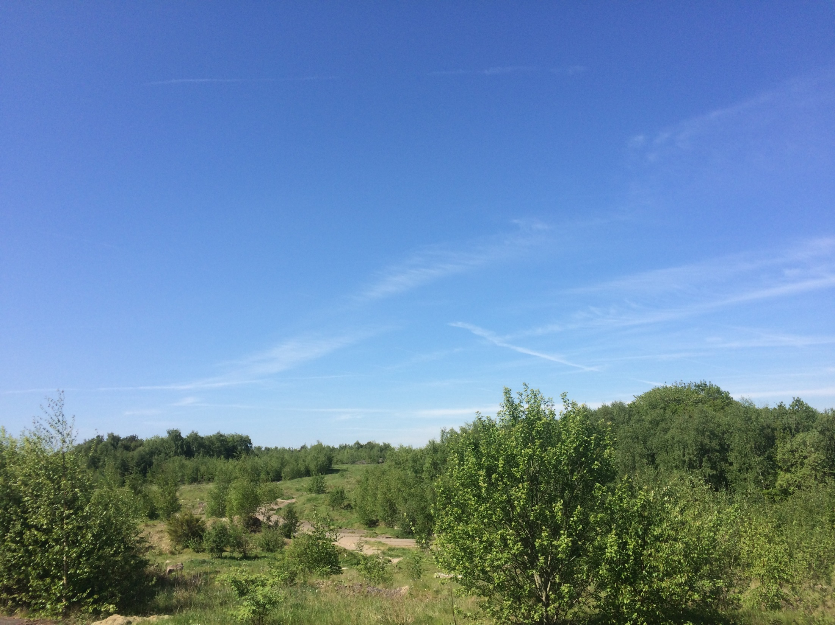
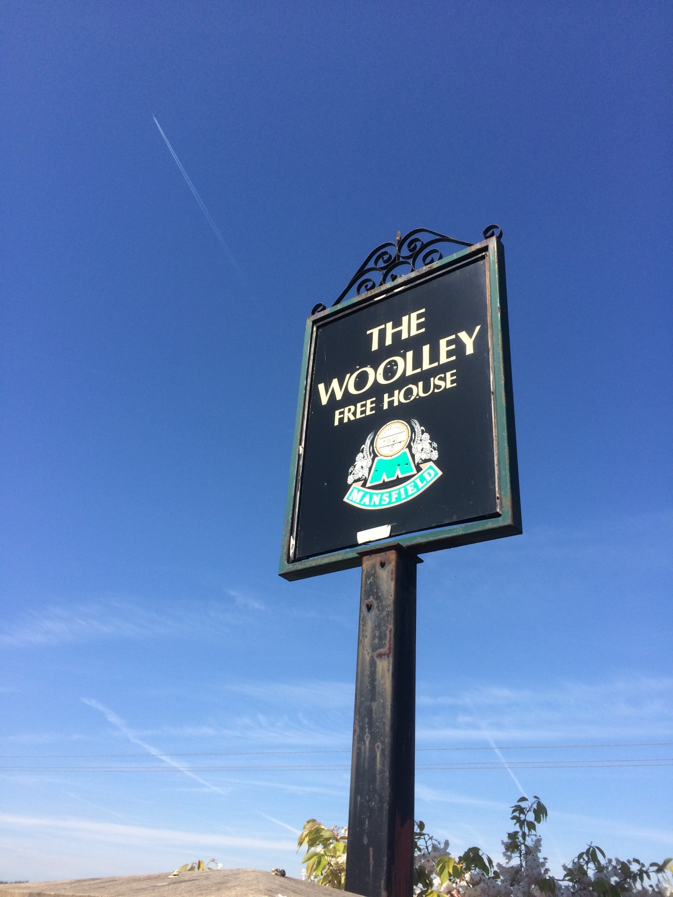
Notes:
(If you would like to know more about Woolley Colliery there is a remarkable book by Eddie Downes called Yorkshire Collieries 1947 - 1994. In the chapter about Woolley Colliery he writes in great detail about its history and importance to the yorkshire coal fields. It will break your heart)

Slide 32
Notes:
Leaving Woolley Colliery Village behind I headed further uphill. All the while I was aware I had to find a spot to paint.
At the very beginning, when this project was just an idea, the whimsical part of me had a notion that I would be able to find a spot on every 3 mile stage where I could see a great panorama before me. I would paint that panorama on 3 panels and move on to the next spot. I would thus produce 60 paintings portraying a complete 360 degree view from the Wakefield District looking outwards.
The more realistic part of me knew that Wakefield District is not a perfectly circular hill and the rest of the world is not flat, the conditions required for this plan to work.
The bit of me I try to listen to most told me not to let the fact that it wouldn't work put me off from actually doing it.
For most of this Stage I had been walking along the bottom of a shallow river valley, which was very picturesque but I couldn't see more than 500 yards in either direction due to trees.
The walk up the hill towards Woolley Village also had limited viewpoints and I was beginning to realise that at the heart of this whole project was a grand folly.

Slide 33
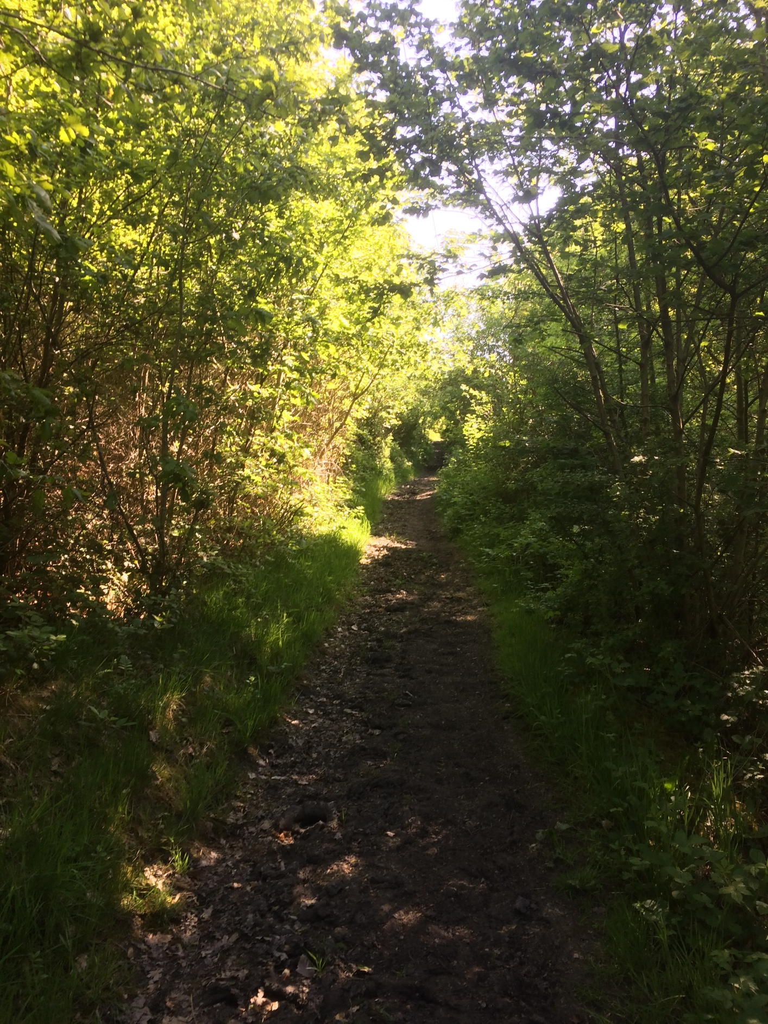
Notes:
I continued up the hill through a tunnel of trees.
I amused myself with various plan Bs.
I would produce 60 paintings of bark/brick walls/bus shelters!
I was nearing the end of stage 1 and also my tether.
Suddenly the tree line dropped away and I was in open fields at the top of Woolley Edge. Turning around I could see for miles, from Emley Moor mast, across the Dearne Valley where I had just walked and over to Barnsley. Exactly the view I was looking and hoping for.

Slide 34
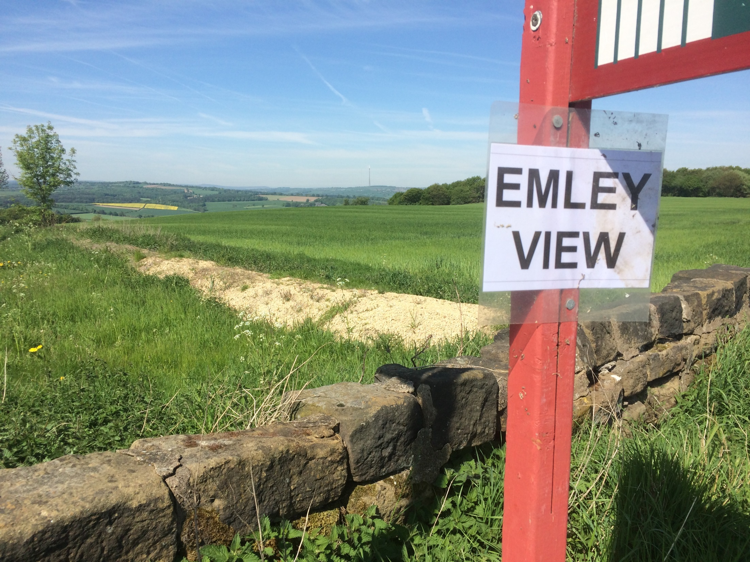
Notes:
Had I Googled Emily View I might have found it sooner.
I was very lucky. All I needed now was to be lucky the following 19 times and the plan would work.
I carried on my journey until I reached the end of Stage 1, a few hundred yards away near Staincross, I marked the route I had taken.

Slide 35
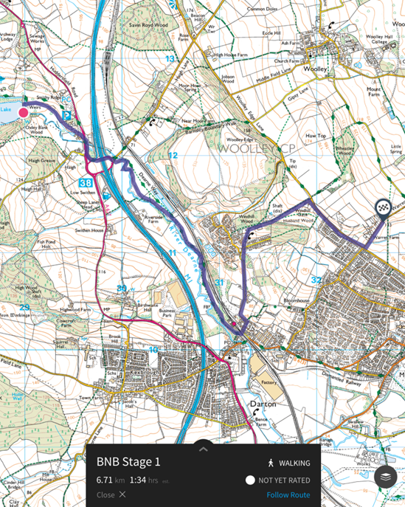
Notes:
then turned back to my chosen viewpoint.
I found a spot on the footpath, next to a converted farm building, to paint.
And I thoroughly enjoyed it.
I had chosen to paint with acrylics, a medium I hadn't used for over 20 years, mainly because I thought it would produce vibrant results and would dry quickly. I had a couple of tryouts earlier in the year and the results had been ok.

Slide 36
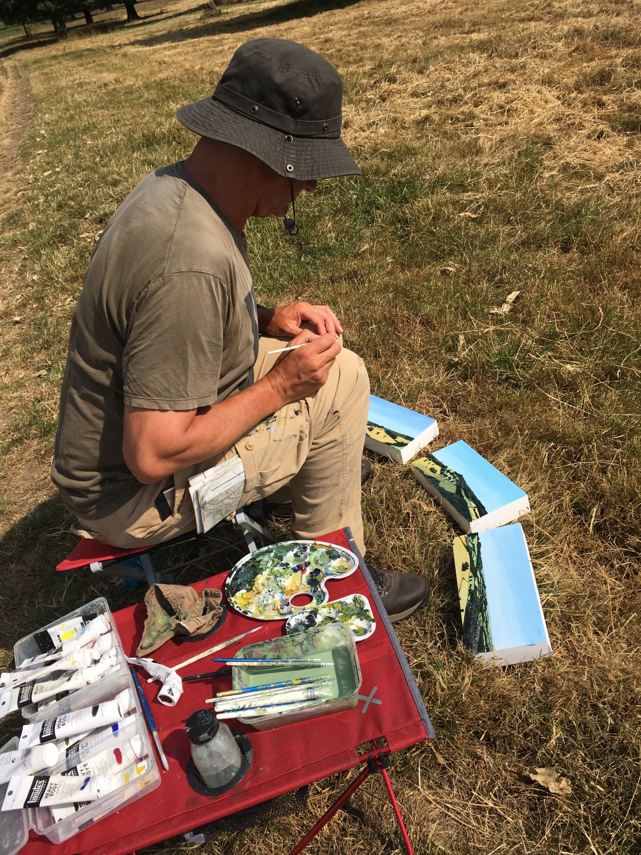
Notes:
On this day, due to extreme heat, the paints dried almost immediately enabling me to work quickly. There was no drawing first, just paint.
I marked in my head where the limits of each of the three panels would be in relation to the landscape.
I painted on one panel at a time, never spending more than 5 minutes on one panel before putting it on the ground, picking up another panel and painting it on my knees. I didn't put the panels together until I had finished them. I didn't want to paint one picture in three sections but rather three paintings that would hopefully fit together.
The owner of the building leant over the wall to say hello. He was a retired teacher and part-time falconer. He kindly refilled my water bottle and I carried on painting.
All the while I was wondering about the painting process and which part of the project was the piece. (I was trying not to use the word 'art' as I kept on recalling the opening sentence to E M Gombrich's The Story Of Art - 'There really is no such thing as Art. There are only artists'.) Was it the paintings, the walking, the conversations?
Or was it the idea?
After about two and a half hours I decided the paintings were finished.
When do you know when a painting is finished? That can be a complicated question and many people will give different answers.
For me, during this project, it was when I stopped painting.

Slide 37
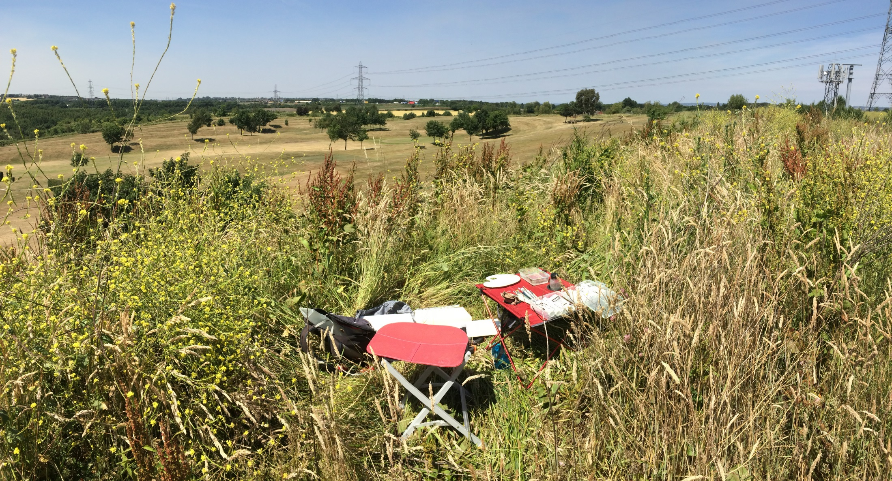
Notes:
Over the coming weeks, most paintings took around 3 hours, some a little less, some over 4 hours. It depended on the complexity of the scene and other factors. (The painting from Stage15 overlooking the M1/M62 junction from the summit of the disused Lofthouse Colliery pit stack took over 4 hours. I was sitting in long grass that played havoc with my hay fever so had to pause every few minutes to sneeze)
I never added to the paintings later on. Once I'd put my paints away, that was it. They were a record of what I saw and painted that day. I didn't want to give myself the luxury of saying 'I can add that later'.
I think that was important. It also made me paint on stages where I really didn't feel like painting. It wasn't an option not to paint.
On those days to come I would often sit down, very grumpily, and tell myself I had to paint, that it would be alright, that in 3 hours time it would be over and the paintings would be completed. It was as if I was expecting someone else to paint the paintings and I just had to sit there and wait until they were done. And it worked.
There were only 3 times when I thought I had a legitimate reason to not finish the paintings.
One was on top of a disused tip near Whitwood overlooking the Aire and Calder Canal. It was at the end of the rather difficult Stage 13 and I could see the rain coming my way. There was no shelter so I would get soaked. I turned the painting face down to protect them and sat and waited it out.

Slide 38
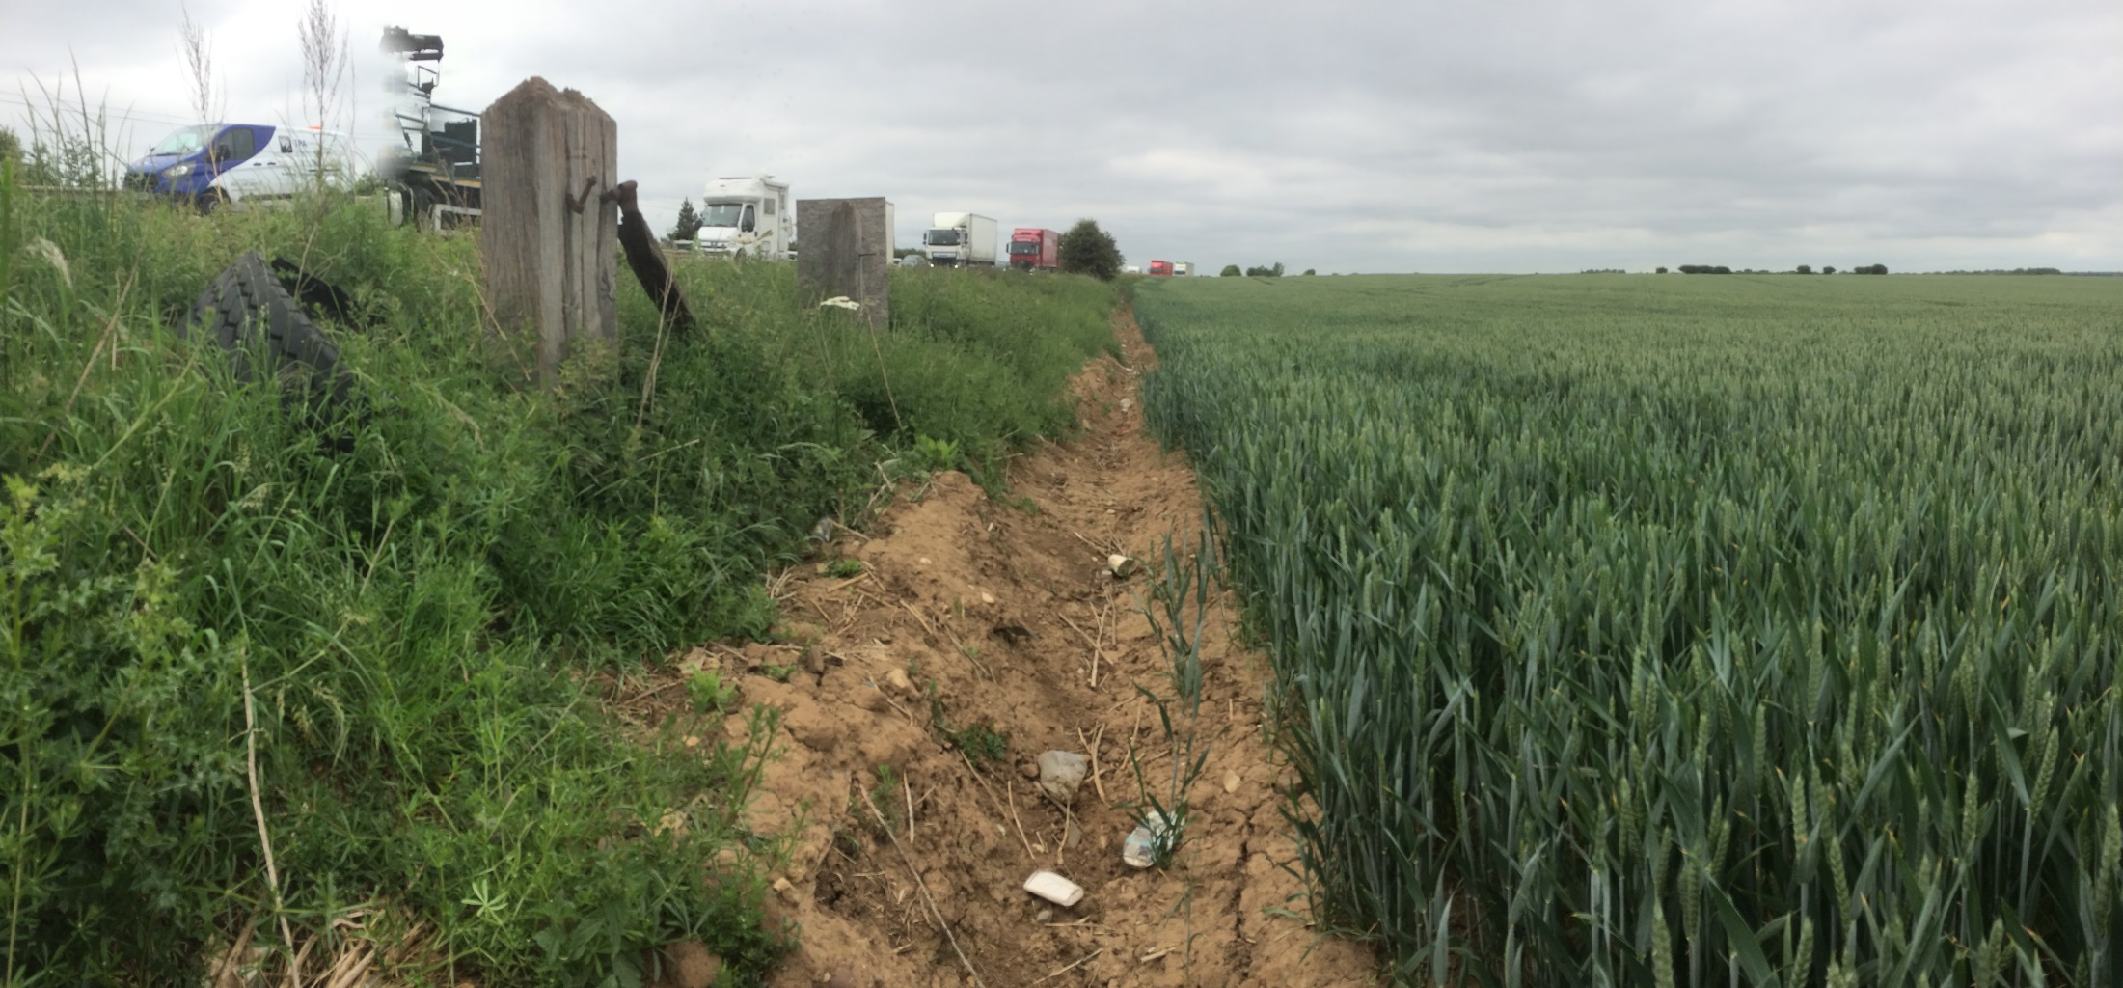
Notes:
Another was Stage 8. Most of that route ran along fields next to the A1
, many impassable due to nettles, brambles and thick woodland. Any footpaths had long since been ploughed up.

Slide 39
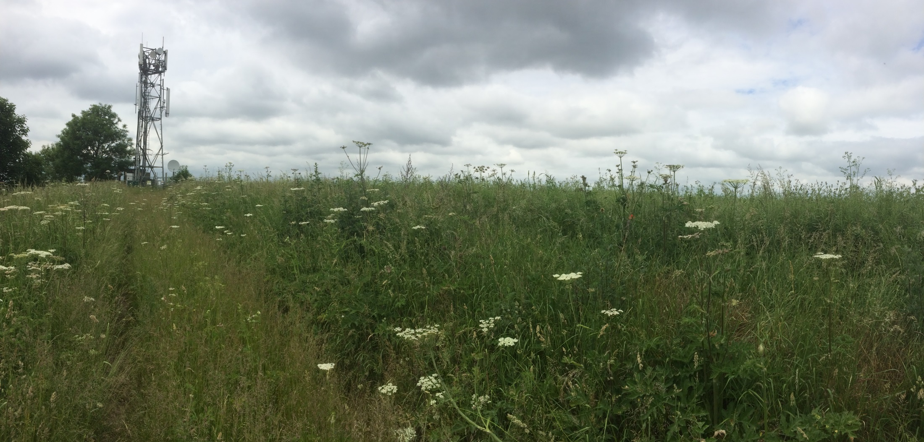
Notes:
Although it hadn't rained the morning dew meant that after an hour my trousers and boots were wet through.

Slide 40
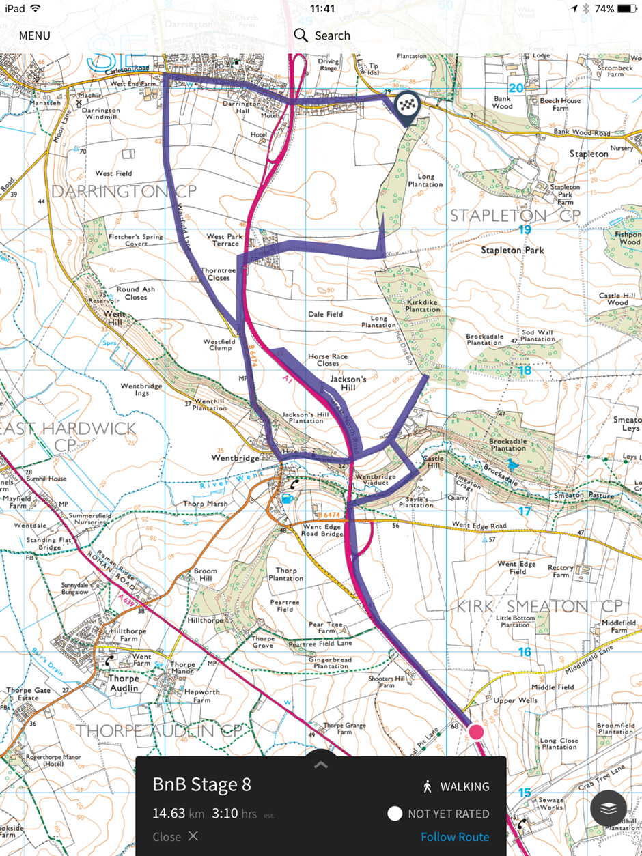
Notes:
I would eventually have to walk 9 miles to cover the three-mile stretch of the boundary.

Slide 41
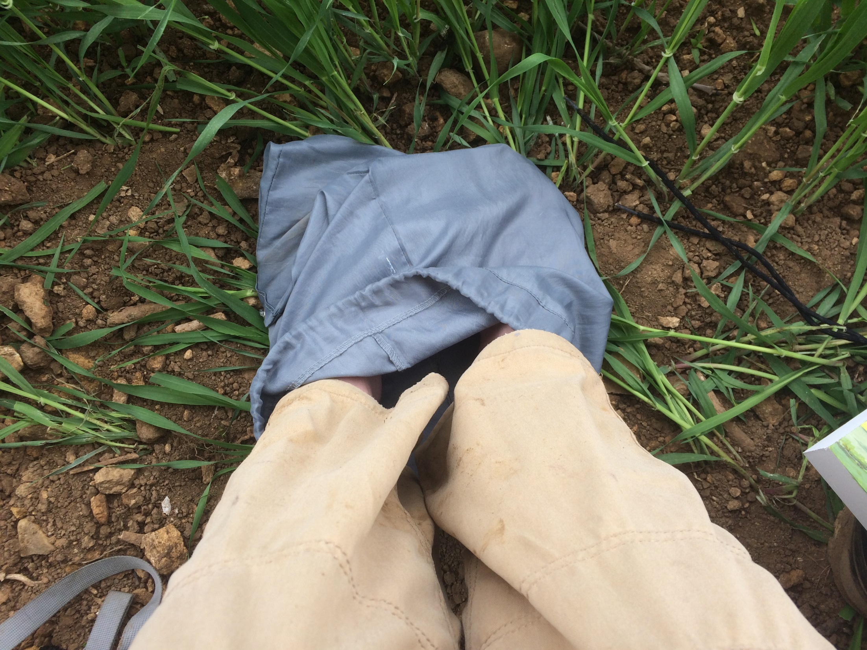
Notes:
I took my boots off hoping they might dry a little, put my feet inside a carrier bag to keep warm, had my back turned to the constant noise of the A1 (which was only 10 ft away) and painted.

Slide 42
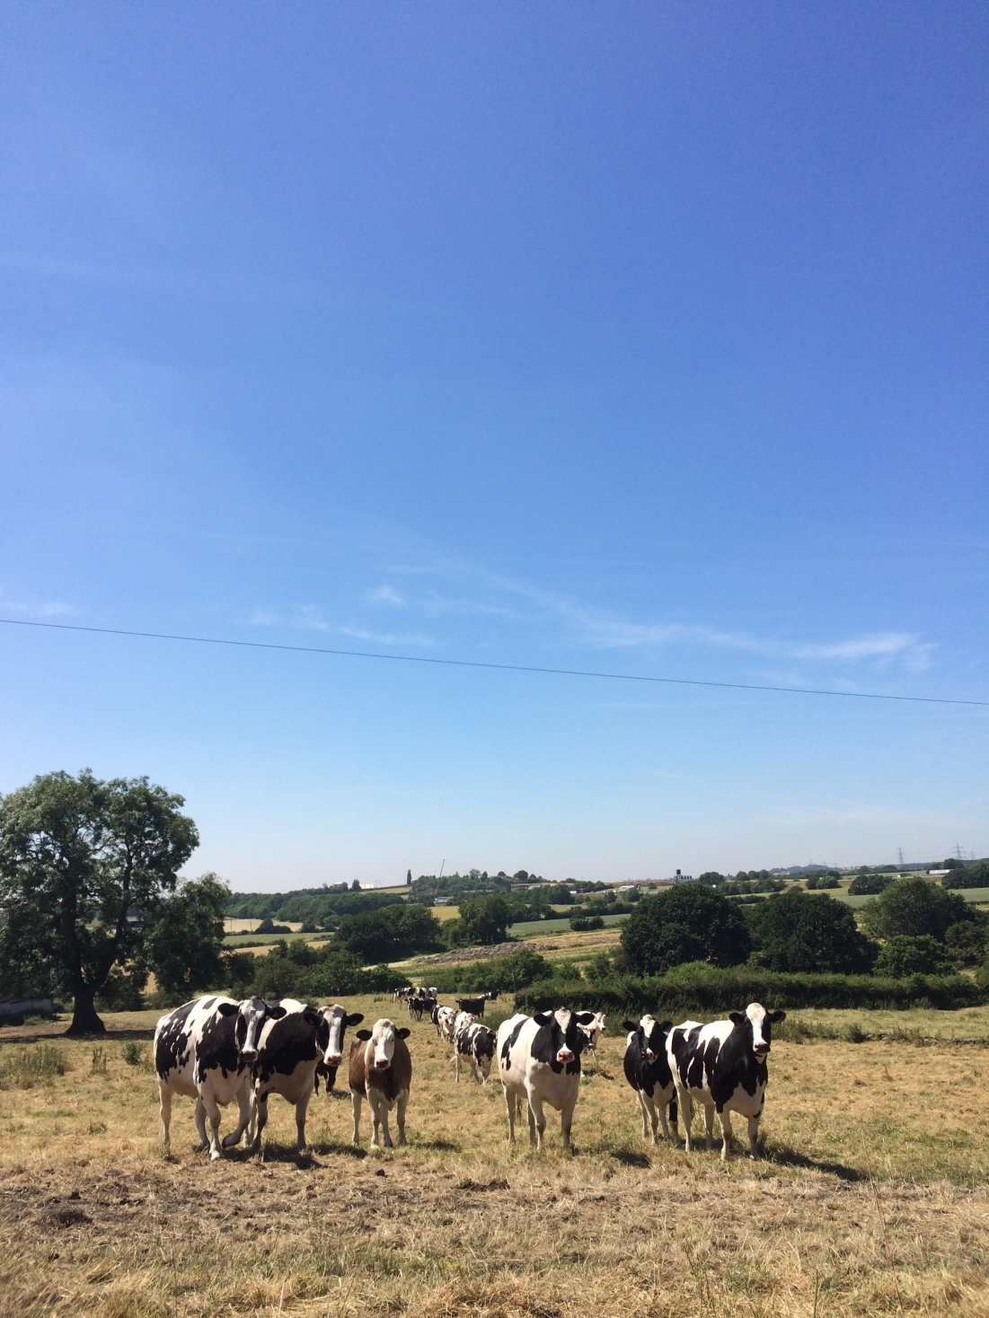
Notes:
And then there was stage 16 and a dry and dusty field overlooking the M1 near Kirkhamgate. I asked the farmer if it was ok for me to paint in his field. He said it was but warned me that the cows were very curious, not dangerous, just curious.

Slide 43
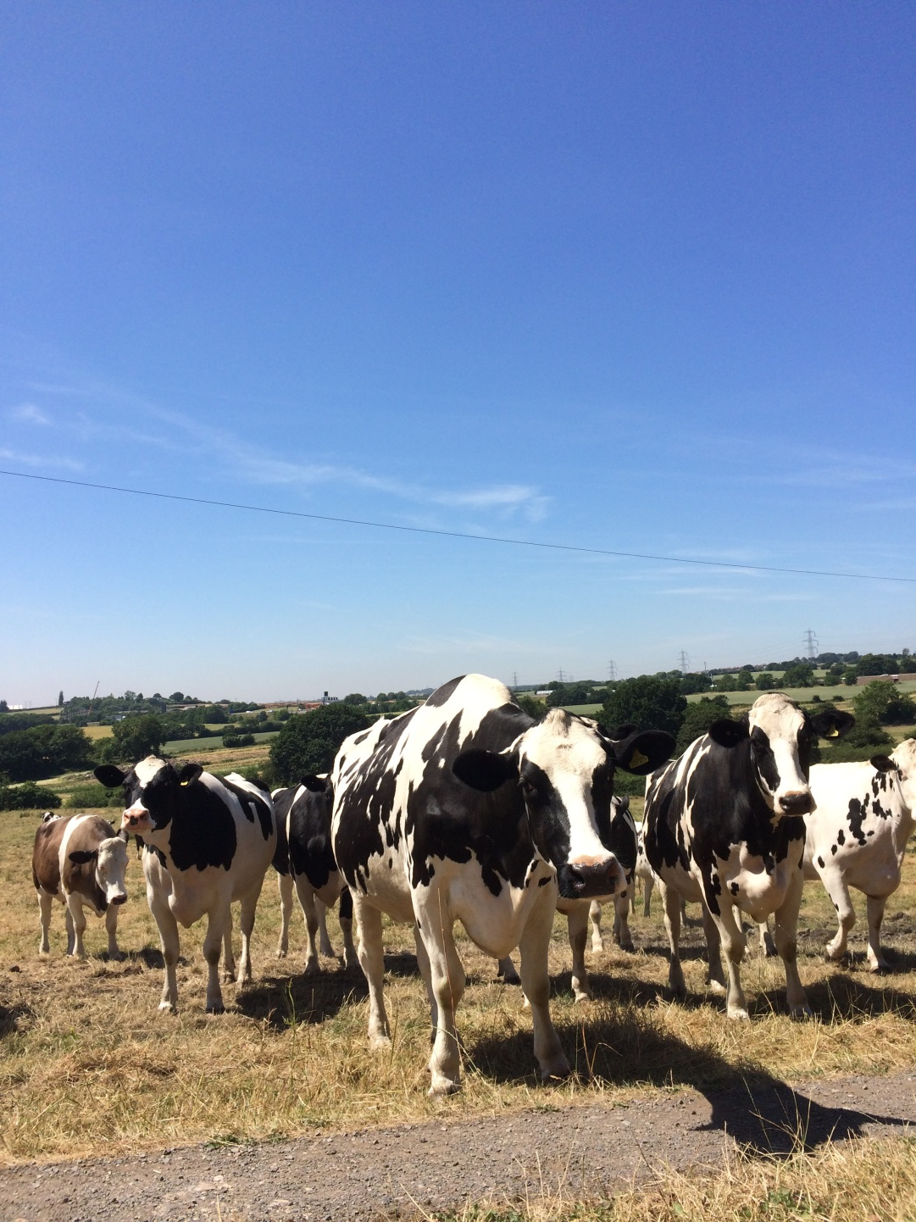
Notes:
I spotted the cows, quite a way away, so settled down to paint. It seemed that every time I looked up the cows got nearer. Like some ruminant version of the children's game Grandmothers Footsteps, or Statues, every time I looked up the cows got nearer and nearer until I was backed up against a wall with one of the cows licking my pallet.

Slide 44
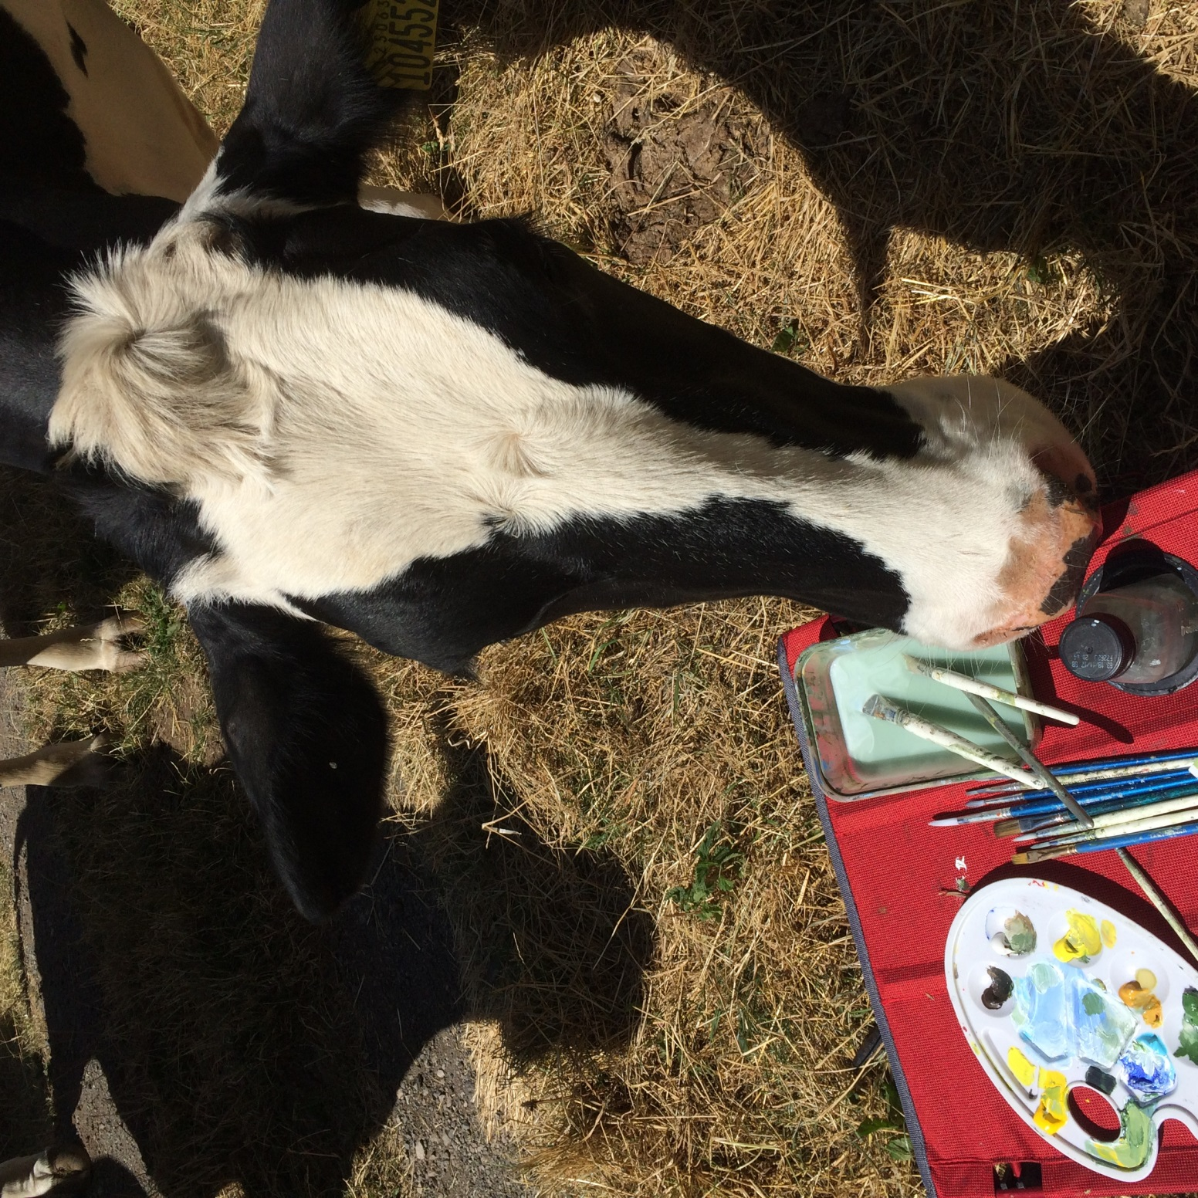
Notes:
At that moment I thought it would be ok to stop and have a nice tale to tell about why three of the paintings were just a few dabs of paint and some curious licking like smudges.
Instead, I shooed the cows away in what I hoped was a confident manner, me walking slowly forwards, gently but firmly wafting both arms in a coordinated underarm bowling technique I figured was appropriate whilst the cows walked impressively backwards. We ebbed and flowed like this for a few minutes until I think they got the message and settled down to continuously fart for the next couple of hours.

Slide 45
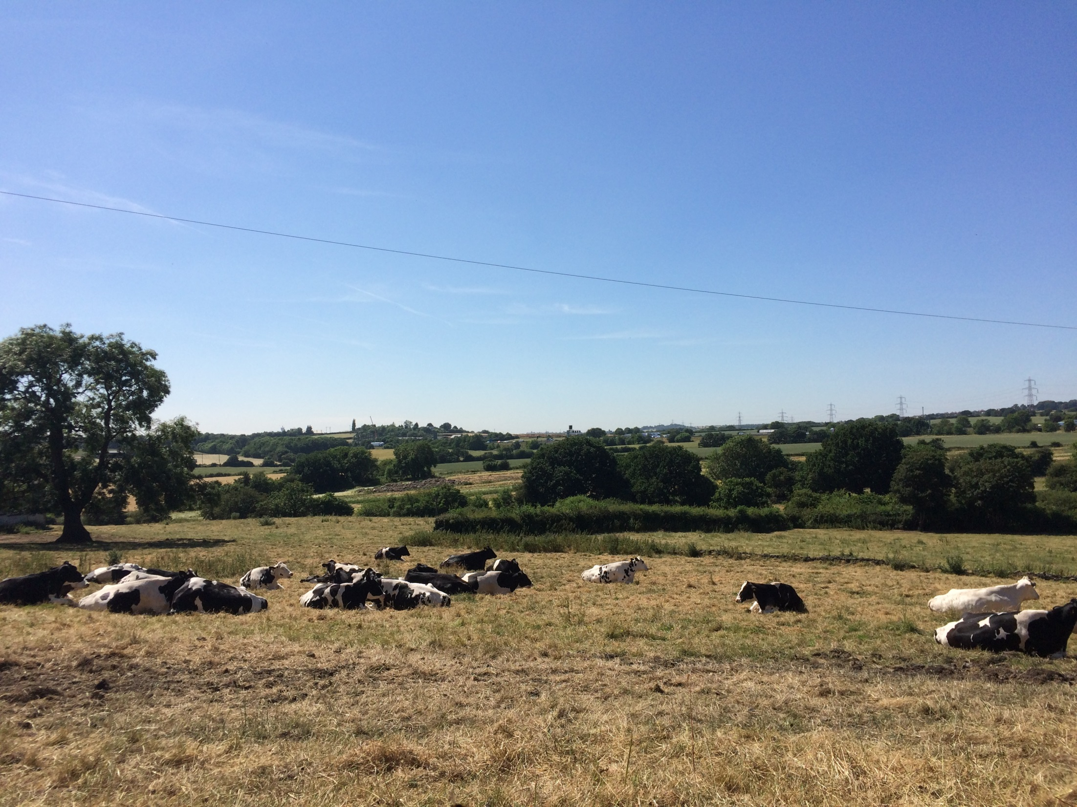

Slide 46
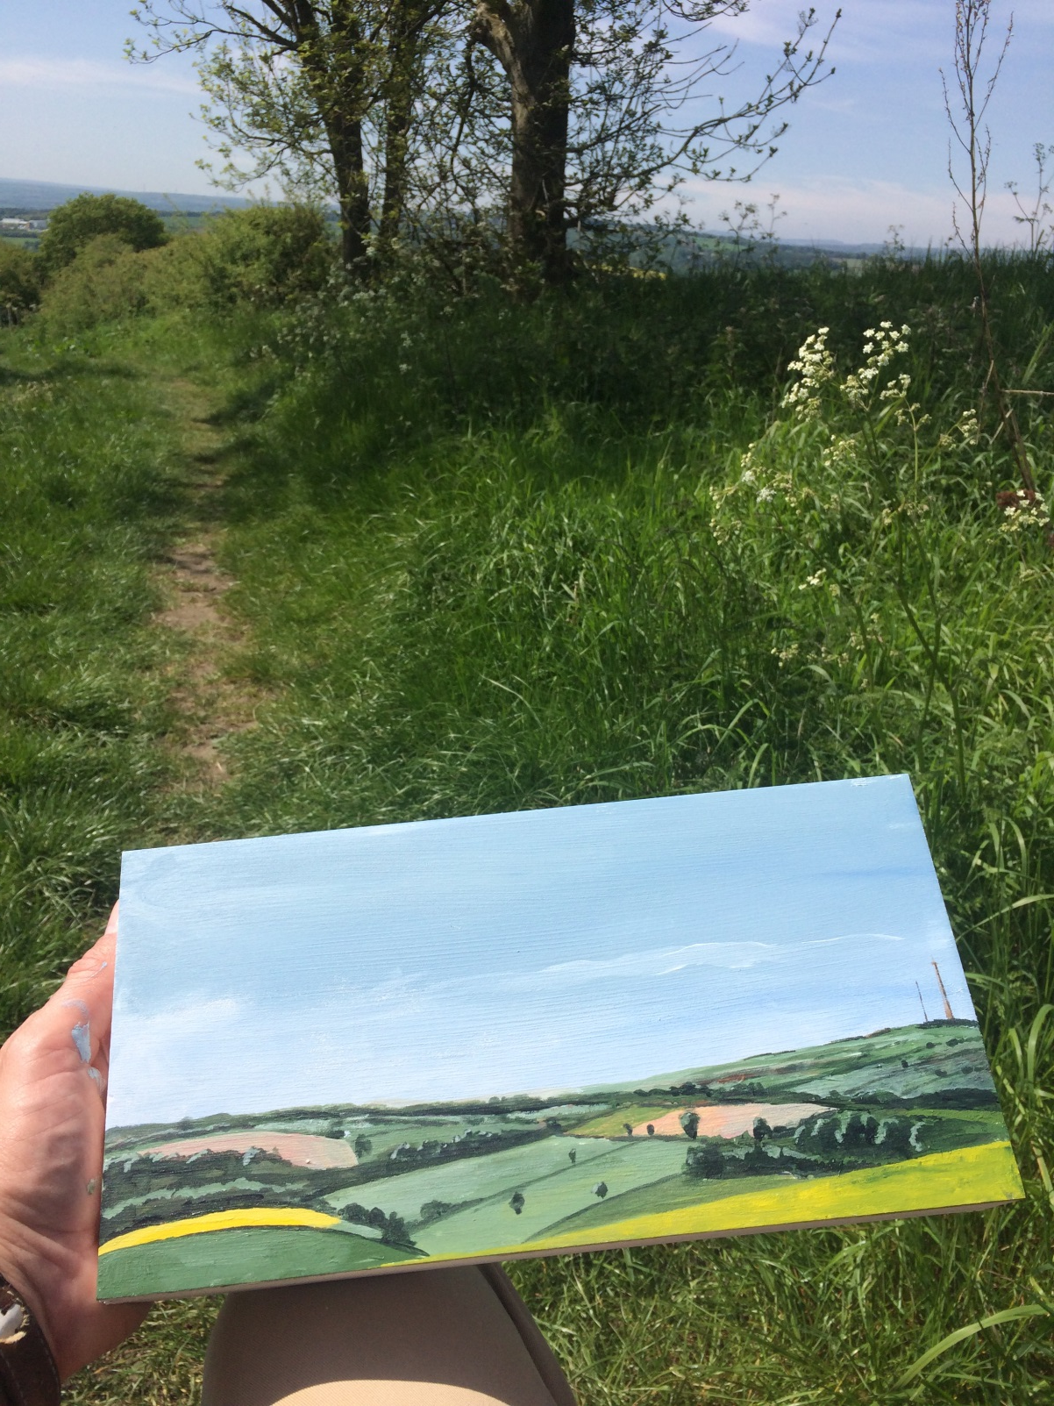
Notes:
Back to Stage 1
When I started I had no idea how the painting would turn out but I was pleased it was quite detailed. You could cross reference the painting with the OS map and find everything was where it should be. I had made a start and I felt confident I could carry this through to the end of the project. Which was a relief

Slide 47
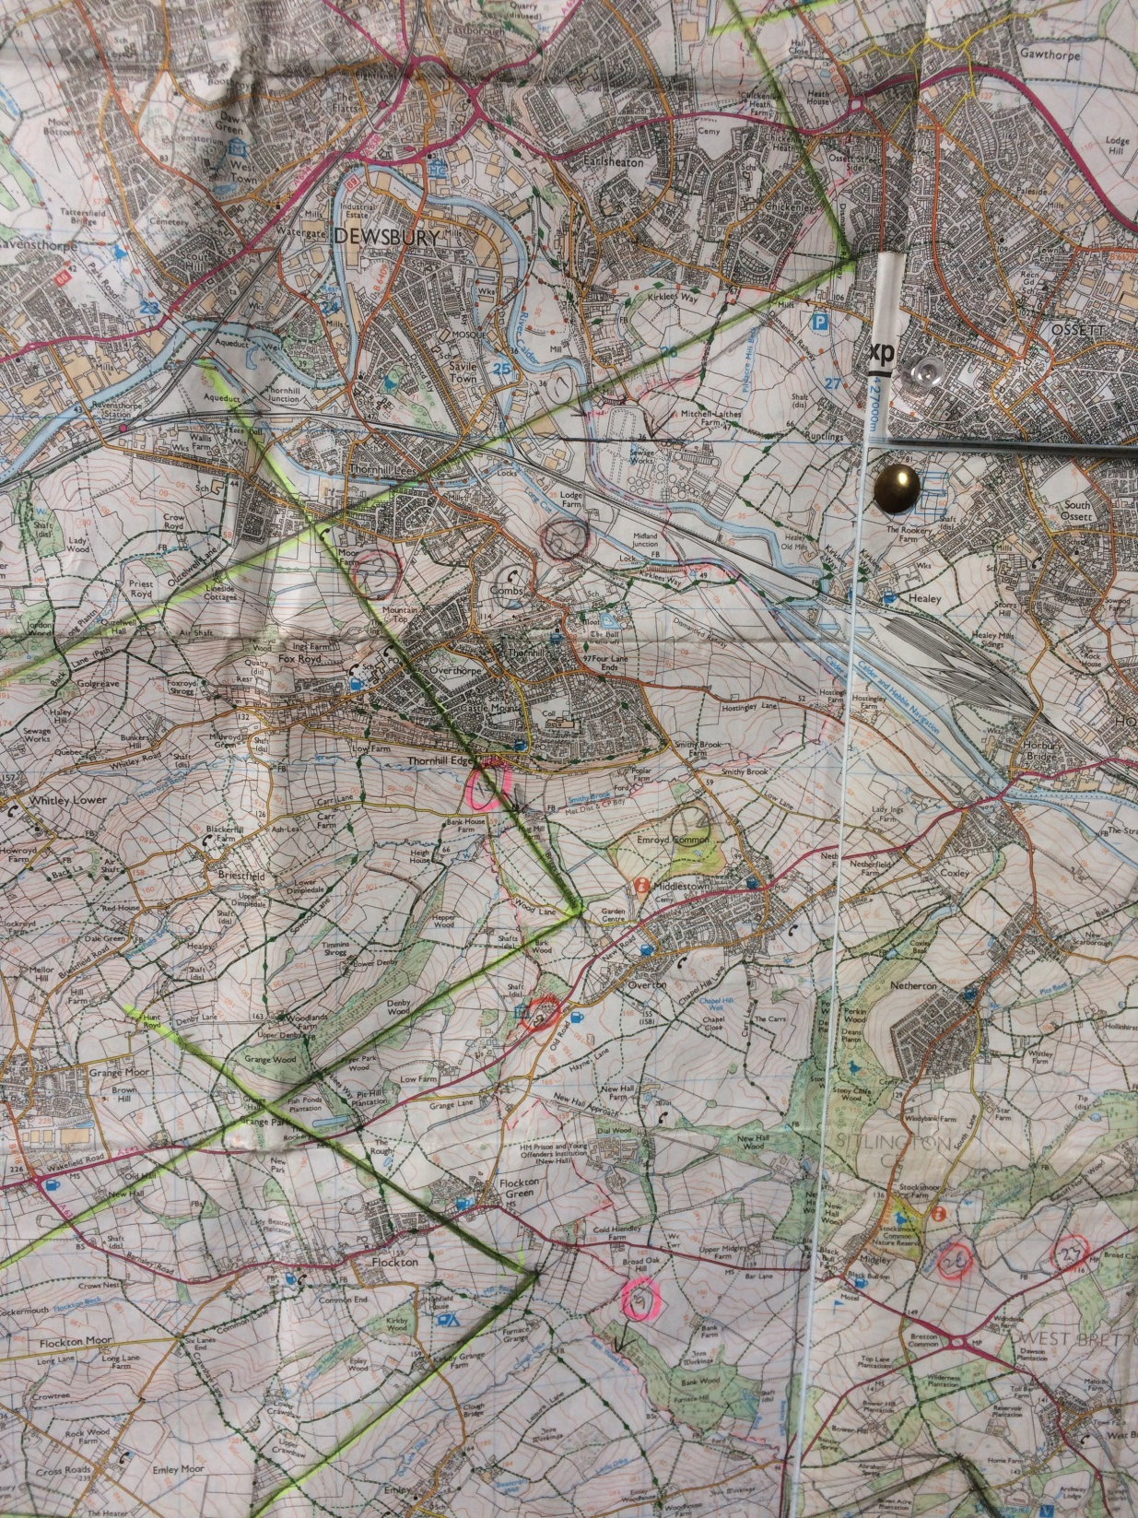
Notes:
I marked on the map the place I had painted from as well as lines marking the field of vision covered by the paintings. These were later highlighted in yellow. I would have to connect with left-hand line on the next staged if I was to hope to complete my plan of a complete panorama.
Note - The photograph below shows the lines marking the overlapping fields of vision at the west of the boundary

Slide 48

Notes:
I packed my paints away, clamped the three panels together for ease of carrying and headed back down the hill, retracing my steps back to where I started the day.
​
Along the way, I saw a stone. I photographed it in situ next to a compass showing how it was aligned to the north and I picked it up I collected a stone on each Stage.
It was a good day and, as I've commented earlier, I just had to be lucky another 19 times.

Slide 49

Notes:
Over the coming weeks the boundary followed footpaths, streams, canal banks, motorways, roads, some times it zigzagged through a field for no apparent reason whatsoever. But I followed it as best I could

Slide 50


Slide 51


Slide 52

Notes:
All the time I was looking for high ground and a place to paint.

Slide 53

Notes:
I met many wonderful people in the way.

Slide 54

Notes:
I had lots of emails from people telling me stories about the places I passed through that I gathered together along with archive photographs.

Slide 55

Notes:
One day, to me great excitement I met these two.
They were from Leeds and were walking the Leeds District Boundary!

Slide 56

Notes:
Most places were predominately rural environments, farmland or wasteland, reclaimed or undeveloped former pit sites, the edgelands of spaces.

Slide 57


Slide 58

Notes:
Lots of spaces were dumping ground with the traces of burned out cars

Slide 59


Notes:
Lots of tires

Slide 60


Notes:
Different sizes

Slide 61

Notes:
After each stage I would update the website with paintings, sound recordings, route maps and contributions sent in via social media and email.

Slide 62

Notes:
On the 6th July I ended up back of YSP at the same place I started from

